Slide 1
ARM 2021.x Changes
Key Features

Slide 2
ARM Academy
https://gdm.talentlms.com
Online platform for learning ARM
NEW course/certification: Staying Current with ARM
Keep up with latest changes in ARM over the last year

Slide 3
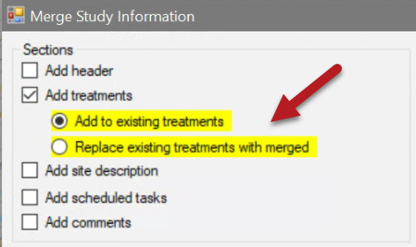
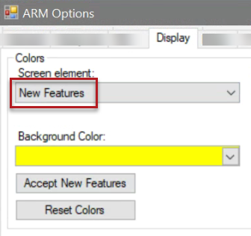
New Feature Highlights
New features/fields are now highlighted for limited time after release
New entry fields: 30 days
New features: first 10 times displayed on-screen
Adjust color in Display Options
Accept New Features to turn off highlight for all current new features/fields
2021.1
Notes:
#12019

Slide 4
Review Protocol Entries
ARM Powered by GDM Solutions

Slide 5
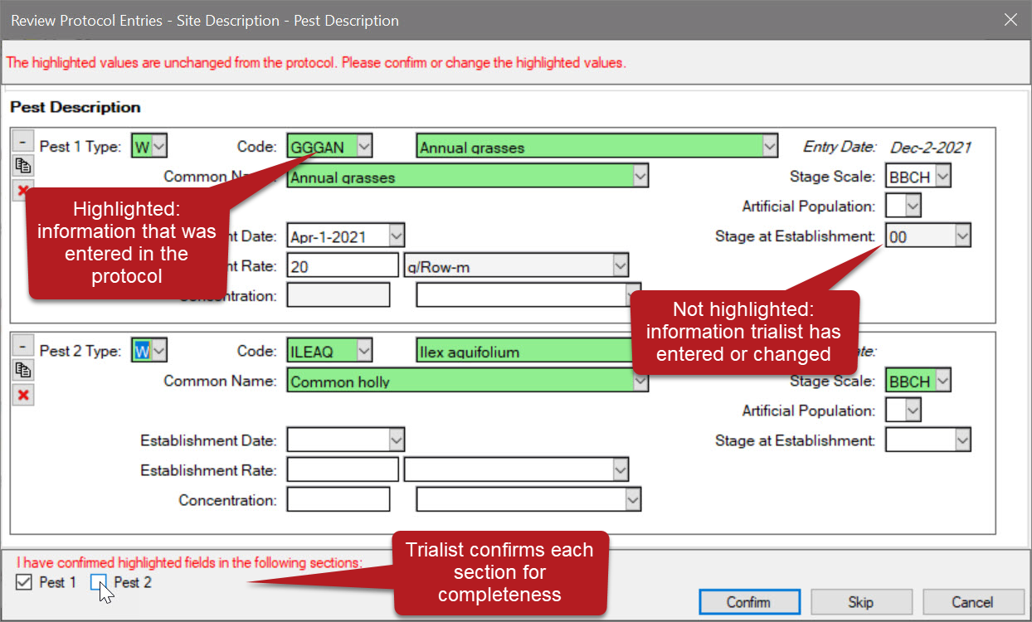
Review Protocol Entries
1 of 3
Review trial for info that was entered in the protocol and has not been changed by the trialist
2021.7
Notes:
#12206

Slide 6
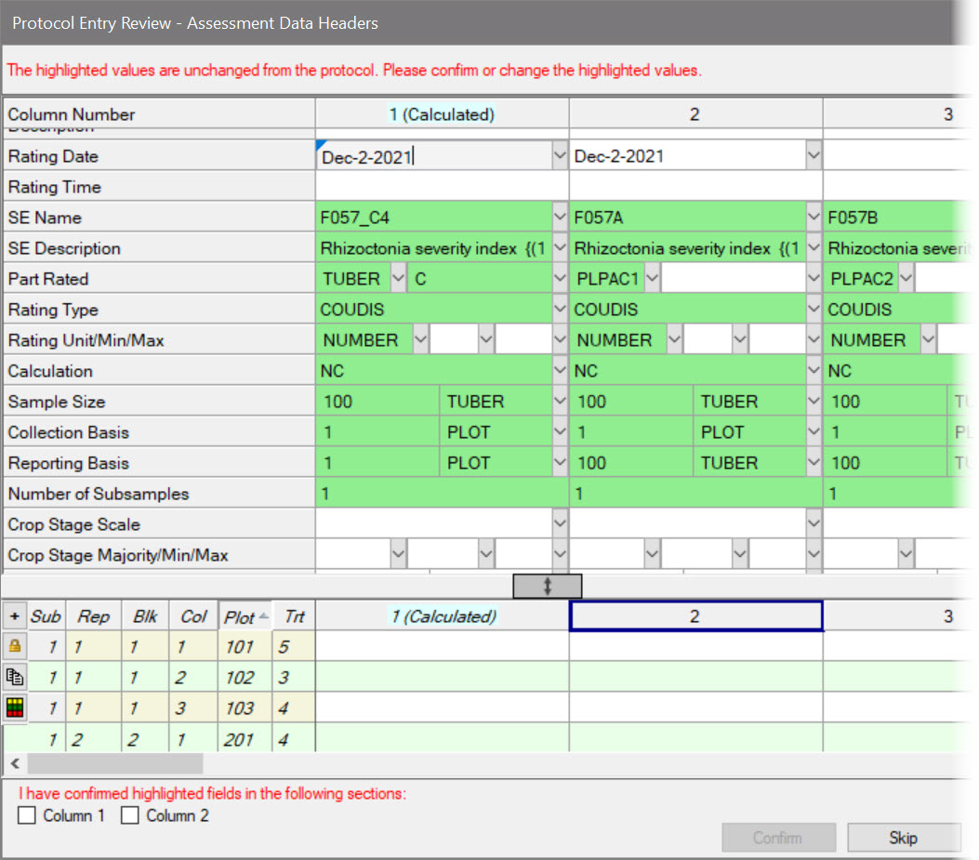
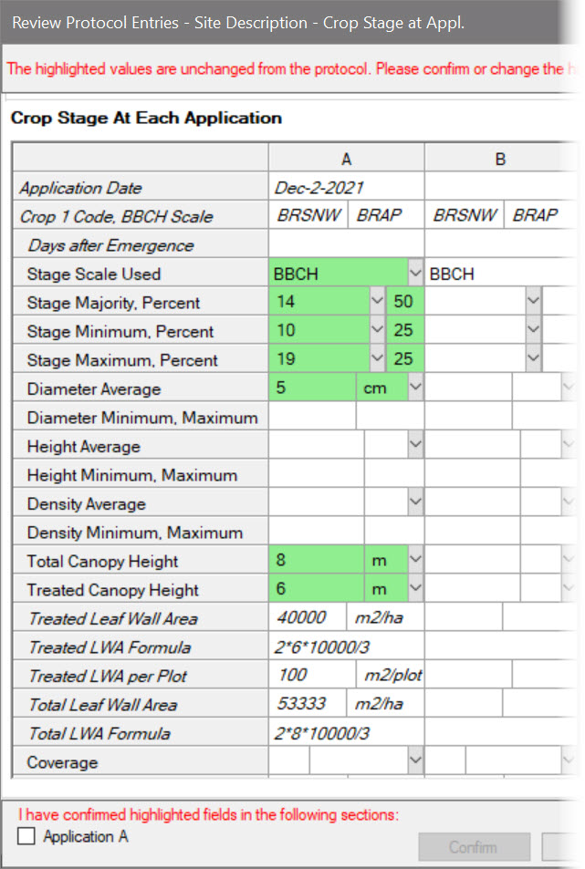
Review Protocol Entries
2 of 3
Performed during trial validation:
When rating date entered, review assessment header fields
When application date entered, review application-related fields
When Trial Status = final, review all other trial fields
2021.7
Notes:
#12206

Slide 7
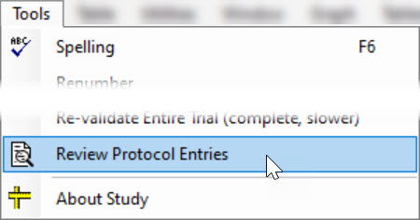
Review Protocol Entries
Feature in Action:
Can also perform the review anytime from Tools menu:
Benefits:
+ Protocol Writers: inform & instruct, with confidence in trial accuracy
+ Trialists: Save time with wizard, instead of manual review of all screens
3 of 3
2021.7
Notes:
#12206
Protocol Writer can inform and instruct, without worry that trialist misses it
Trialist can save time by confirming entries with the wizard, instead of manually reviewing every screen in ARM when first receiving the file from the protocol writer.

Slide 8
User Profile
ARM Powered by GDM Solutions

Slide 9
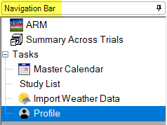
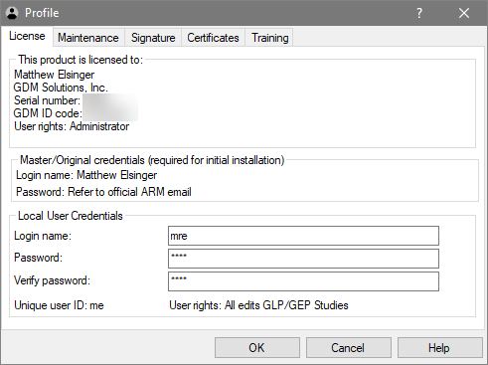
User Profile
A list of settings specific to the ARM licensee.
License
Details about the ARM license
Add a local user or custom password
Maintenance
License maintenance expiration date, renewal invoice
Signature, Certificates - new features in ARM
Training – information for ARM Academy
2021.2
Notes:
#12172

Slide 10
Signature
ARM Powered by GDM Solutions

Slide 11
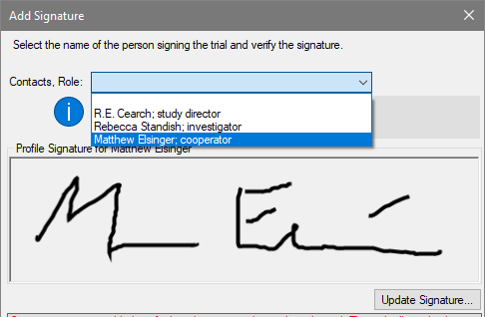
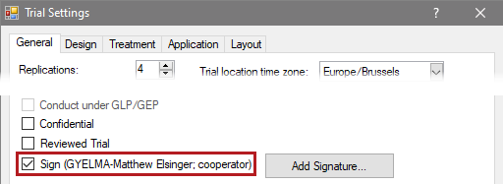
Trial Signature
Add your signature to a trial
Trial Settings > Sign checkbox
Create your signature in user profile
Confirm your role in the trial (fills from Contacts)
1 of 2
2021.2
Notes:
#12209

Slide 12
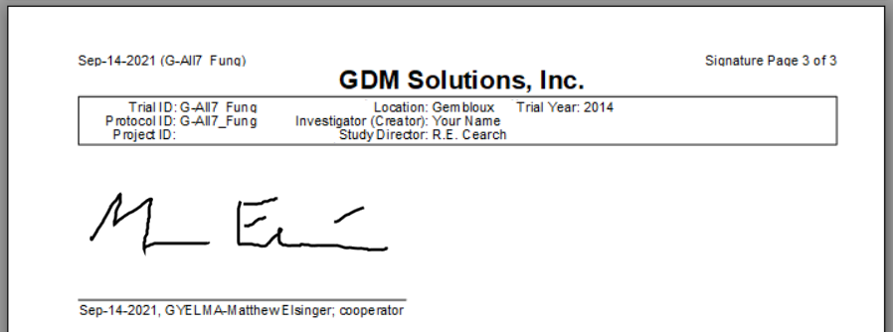
Signature
Add a signature to a trial
Include signatures on reports (Global Report options)
Add a study rule to require a signature
2 of 2
2021.2
Notes:
#12209

Slide 13
Certificates
ARM Powered by GDM Solutions

Slide 14
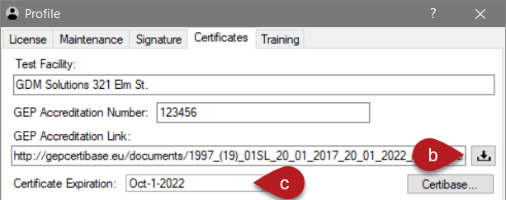
GEP Certificate
Save GEP accreditation / test facility details to user profile
Easy to populate and update each trial
Downloads certificate PDF and attaches to trial
Track your certificate expiration (not saved in trials)
2021.2
Notes:
#12172

Slide 15
Protocol Writers
ARM Powered by GDM Solutions

Slide 16
Validation updates
Value fields are not required when unit field contains an entry
Now enter units to instruct the trialist, without throwing errors
Tip: Add a study rule to require the value for the trialist
2021.2
Notes:
#12197

Slide 17
AOV Means Table report
ARM Powered by GDM Solutions

Slide 18
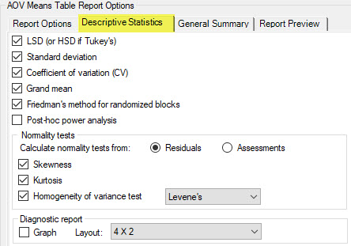
Descriptive Statistics
Moved options group to its own section/tab
Same options, new location!
2021.0
Notes:
#11894

Slide 19
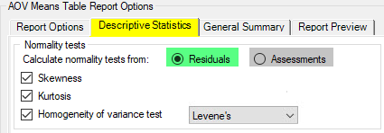
Descriptive Statistics
Specify how normality tests are calculated/reported
*Residuals: contemporary approach; matches Column Diagnostics
Assessments: the historical approach; not recommended
*Default
2021.0
Notes:
#11894
Goal is to match choices made in data review (Column Diagnostics panel) to the reporting process. Thus default=Residuals
If still using the old way, or want to duplicate an historical report, set to Assessments.

Slide 20
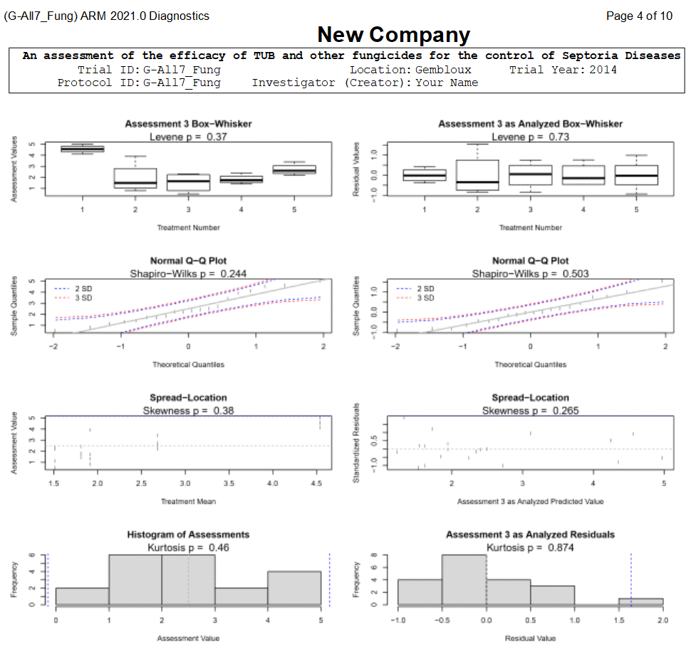
Descriptive Statistics
Include Diagnostic Graphs with AOV report
Same graphs from Column Diagnostics panel
2021.0
Notes:
#11894

Slide 21
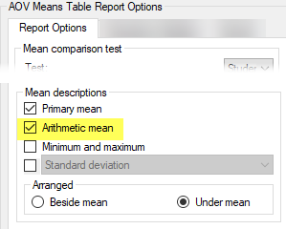
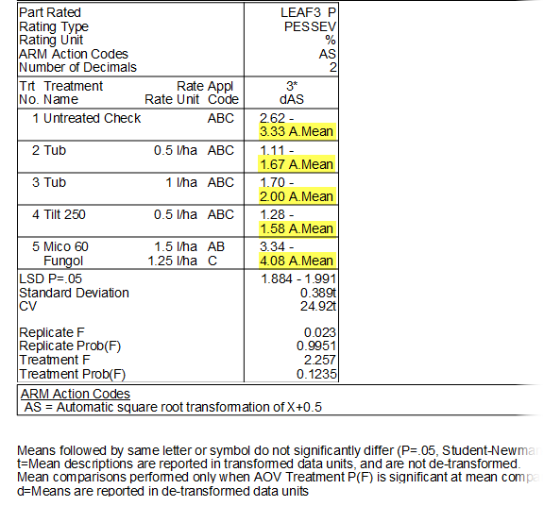
Arithmetic mean
New option to include arithmetic mean on report
Why? Analyzed means are not always arithmetic:
Data correction transformations
Missing data adjustments
1 of 2
2021.0
Notes:
#11930
Data correction transformations produce weighted means on reports (because: perform inverse of transformation back to original units of data) to be statistically accurate.
Less technical audiences may desire the "raw" arithmetic means of what actually occurred in the plot, while presenting the appropriate statistics.

Slide 22
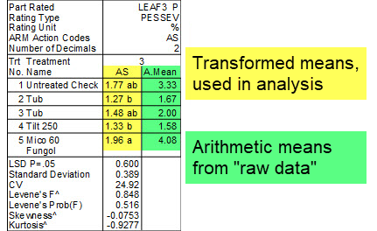
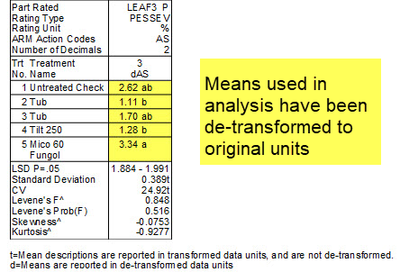
Arithmetic mean
What should I choose?
For non-statistical audience:
Include arithmetic mean, no de-transform needed
For statistical audience:
De-transform means, no arithmetic mean needed
2 of 2
2021.0
Notes:
#11930
For a non-technical audience, the significance letters may be more important than mean values. The arithmetic mean provide the "raw data" results while still presenting valid statistical findings.
For a statistical audience, the de-transformed means provide a statistically-correct presentation, while still reporting means in their original units for comparison. (The key is that these are weighted means, so sometimes confuses people who may be looking for the "raw" arithmetic mean. This is why we added this new option!)

Slide 23
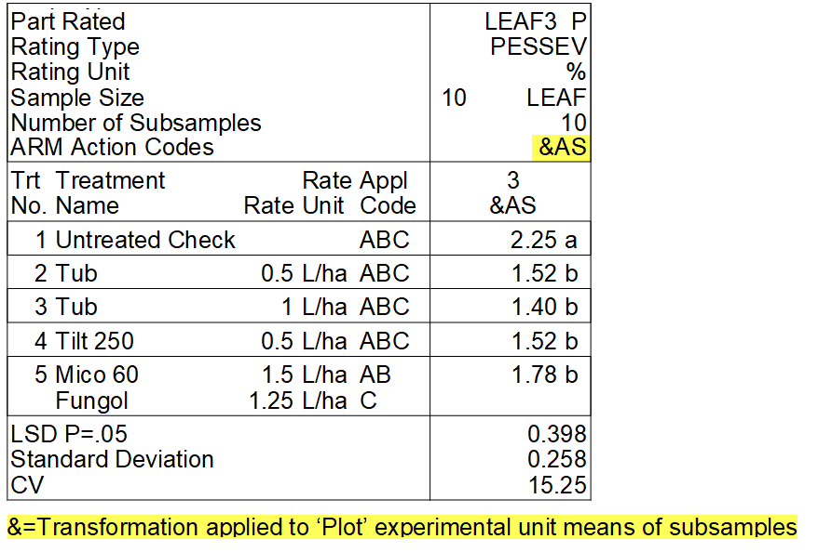
Subsample Data
Automatic transformations (AS, AA, AL) now applied to plot mean
Previously: applied to individual subsample values, then averaged
Why? AOV analyzes plot means, not subsample values; so transforms should apply to plot means too
1 of 2
2021.0
Notes:
#11704
Pertains to data correction transformations (AA, AS, AL) only, for now.
(Expansion to any transformation with subsamples is possible in the future)
Goal of subsamples: obtain a rating that is representative of the entire plot (may require multiple assessments ….

Slide 24
Subsample Data
Control this behavior with new General Summary option:
When selected, adds & symbol to the transform Action Code (for report only, entered data is not changed)
2 of 2
2021.0
Notes:
#11704
Recommended: Option=ON. Only turn off if want to duplicate previous analysis/report.

Slide 25
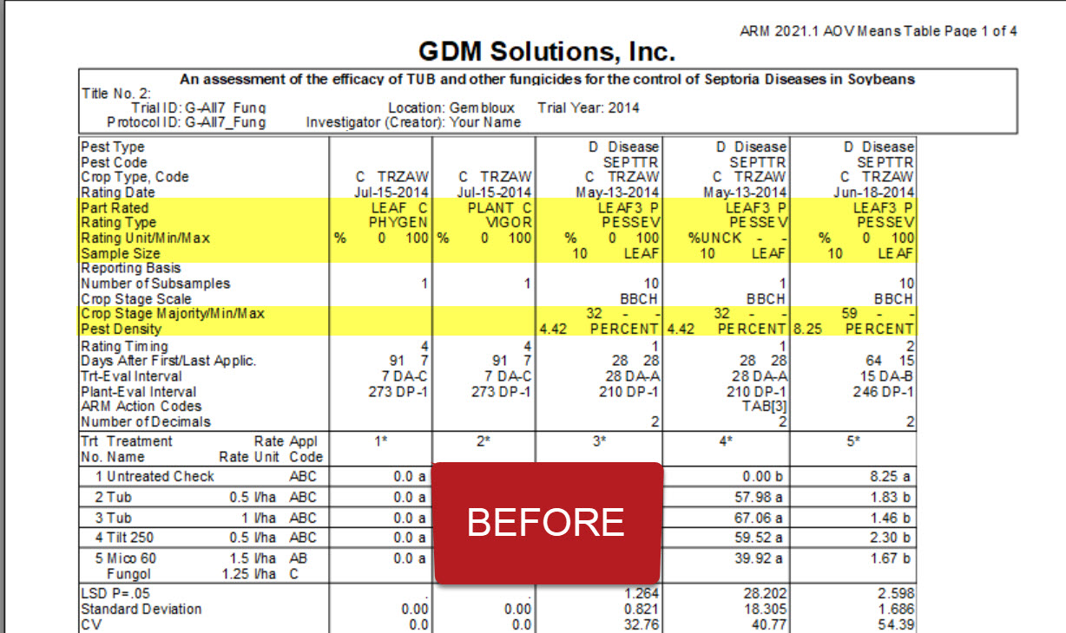
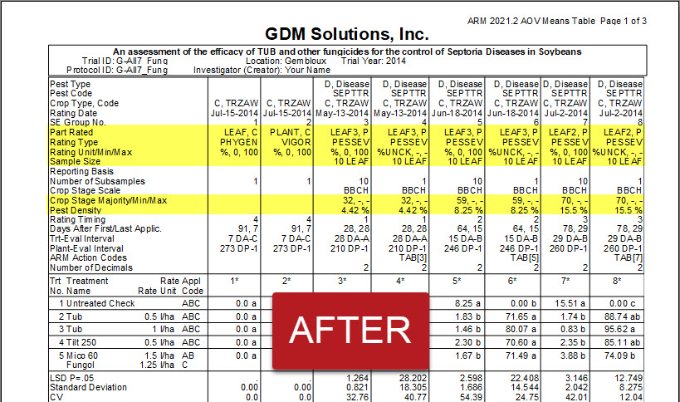
Report Compression
Improved spacing to reduce unnecessary space on Protocol/Site Description, Summary reports
2021.2
Notes:
#12122

Slide 26
Multi-factor Designs
ARM Powered by GDM Solutions

Slide 27
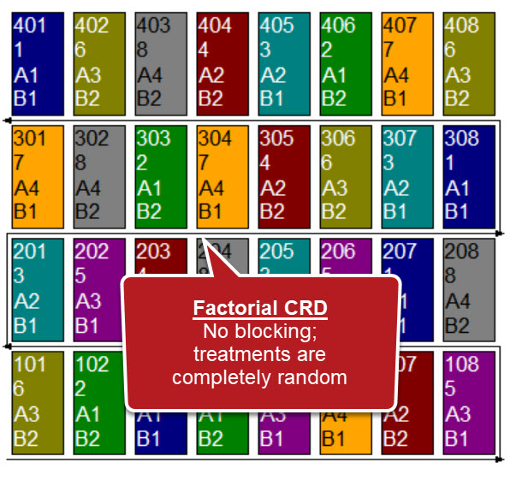
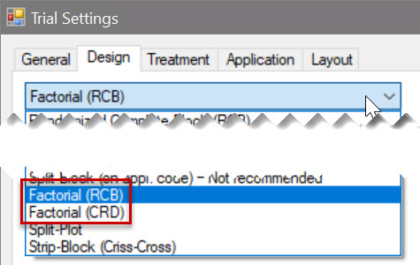
Factorial CRD
Completely Random Design w/factorial treatment arrangement
Useful where blocking is not needed (e.g. greenhouse/lab trials)
Previous "Factorial" design renamed to "Factorial RCB" to clarify
2021.7
Notes:
#12283
useful in the case of pot, growth chamber, or lab trials, where blocking is not needed.

Slide 28
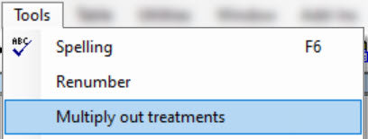
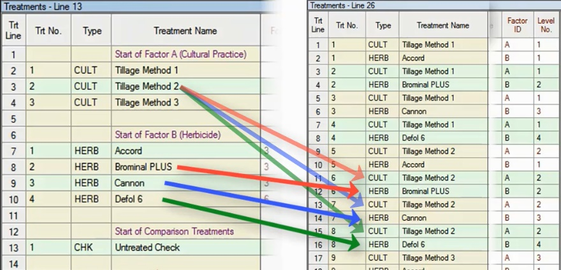
Multiply out treatments
Convert protocol factor levels to the full "multiplied out" list
Useful to edit "full" treatment list while still in the protocol
1 of 2
2021.7
Notes:
#12170

Slide 29
Multiply out treatments
Feature in Action:
Note: once protocol treatments are converted, they cannot be reverted back to the original factor level view. Only Edit > Undo can reverse this action.
2 of 2
2021.7
Notes:
#12170

Slide 30
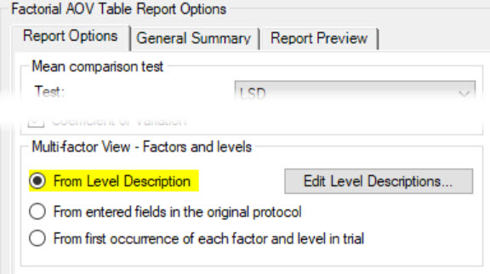
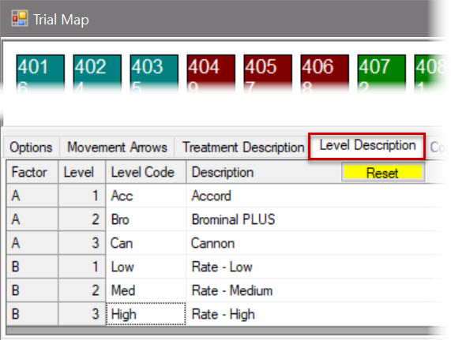
Reporting
New option to print Level Descriptions instead of treatment info
Affects: FAOV Table, Treatments reports for multi-factor studies
Use Reset button on Trial Map to re-select fields to include in Description
2021.7
Notes:
#12288
This new option is the default!

Slide 31
Assessment Data
ARM Powered by GDM Solutions

Slide 32
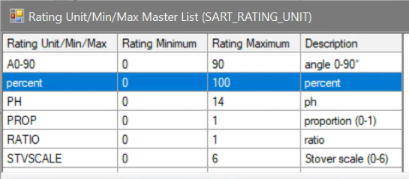
Data Limits
New fields: Rating Unit Minimum and Maximum
Define the smallest and largest value that is valid for the assessment
Auto-filled for units that already have data limits pre-defined
1 of 2
2021.1
Notes:
#12025

Slide 33
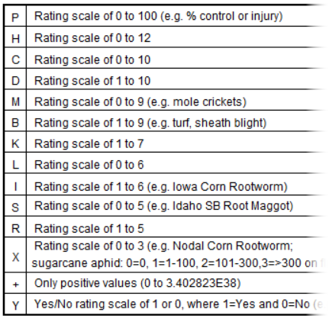
Data Limits
Removed ARM Action Codes that define data limits
Use new Min/Max fields instead
Set Minimum=0 to replace "+"
Set Min=0,Max=1 to replace "Y"
Why? Data limits are now explicit and are set in only one place (previously: Action Code, Rating Type, and/or Unit)
2 of 2
2021.1
Notes:
#11984

Slide 34
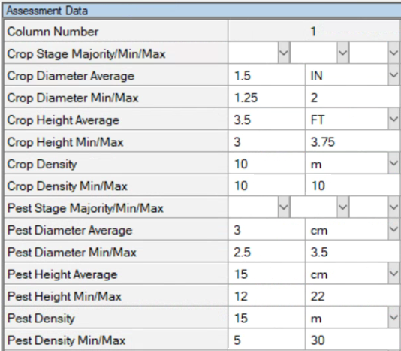
New Fields
Added fields for documenting:
Diameter
Height
Density
For both Crop and Pest
Include Average across trial, smallest (Min) and largest (Max)
2021.1
Notes:
Document plant diameter, height, and density @ time of assessment. Included for both Crop and Pest/Weed, with places for the average, smallest and largest
#11984

Slide 35
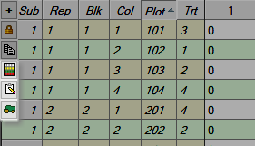
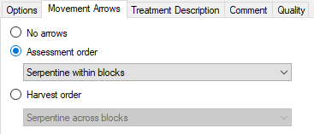
Assessment Data
Feature in Action:
New shortcut buttons added to plot description
Trial Map
Sort by – Assessment Order
Sort by – Harvest Order
Tip: Set the Assessment & Harvest orders on the Trial Map > Movement Arrows
2021.0
Notes:
#11919

Slide 36
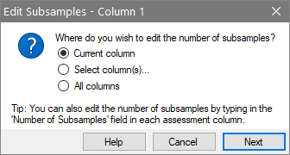
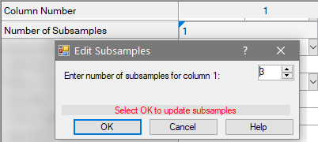
Subsamples
New wizard replaces Tools > Add/Delete Subsamples commands
Change subsamples across whole trial, or specific column(s)
1 of 2
2021.0
Notes:
#11884

Slide 37
Subsamples
Feature in Action:
Maximum subsamples property of a trial now automatically updates when appropriate
Previously Add a column of 10 subsamples, then change all columns to 1:
Trial Max subsamples = 10 still
2 of 2
2021.0
Notes:
#11884
Really only impacts existing users who may be used to having to adjust subsamples "the old way"

Slide 38
Assessment Images
Can now remove linked images when image file cannot be found
Previously "Remove" button disabled if linked image not available
2021.1
Notes:
#12055

Slide 39
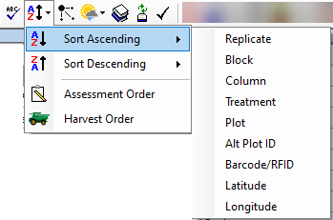
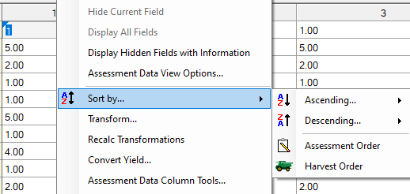
Sort
Toolbar: Sort commands combined into one button
Sub-options depend on current editor
Same impact on right-click menu:
2021.0
Notes:
#11919
Previously, toolbar buttons would shift slightly depending on the editor visible, because different sorts were available in different areas.
Now toolbar will remain consistent, and sub-options can vary

Slide 40
Site Description
ARM Powered by GDM Solutions

Slide 41
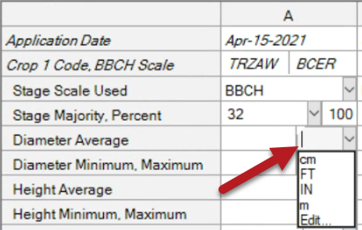
Unit Lists
Drop-down list instead of Validation List dialog
Added for fields with short, limited lists
Faster data entry! Old vs. New:
2021.1
Notes:
Can still use F9 or select Edit… to view "classic" list dialog
#12052

Slide 42
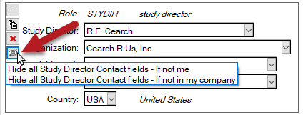
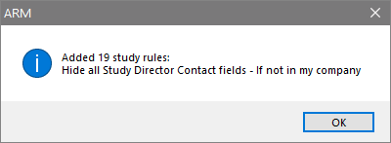
Contacts
New shortcut button
Adds study rules to hide all details for that contact
Note: For "other contacts" repeating section, button hides ALL "other contacts"
2021.0
Notes:
#11948
Especially for GDPR requirements

Slide 43
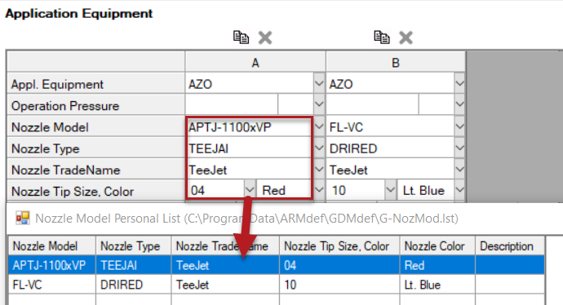
Nozzle Description
New multi-field personal list to describe application nozzles
Nozzle Model (was 'Nozzle Size')
Nozzle Type
Nozzle TradeName (new)
Nozzle Tip Size
Nozzle Color (new)
2021.1
Notes:
#12025

Slide 44
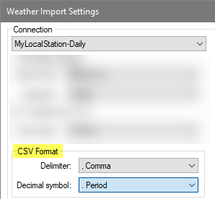
Weather Import
New options for custom weather import
Delimiter: character used to separate columns in .csv
Decimal symbol: used in numeric values (e.g. 14.2 or 14,2)
Previously did not recognize delimiter=semicolon
2021.0
Notes:
#11937
Changed so the column delimiter and decimal symbol of the CSV weather data file can be specified in the custom weather import options

Slide 45
Tree/Crop Row Volume
ARM Powered by GDM Solutions

Slide 46
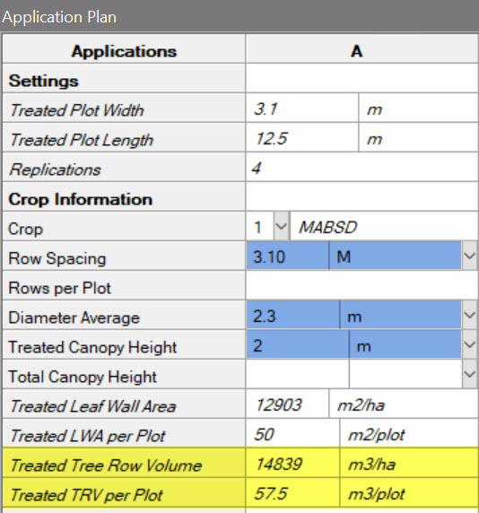
Tree/Crop Row Volume
Now supports tree/crop row volume (TRV) calculations
Treated TRV = Canopy Height * Plant/Row Diameter * 10,000 m3 / Row Spacing
Automatically calculated for applications that have all required information
Tip: The Application Plan displays all fields for TRV and LWA (Leaf Wall Area) in one spot
1 of 3
2021.7
Notes:
#12179/12356

Slide 47
Tree/Crop Row Volume
Adjust product calculations for TRV:
Use new TRV treatment rate unit
Application has calculated TRV
Spray/Seeding Plan identifies when TRV is used in calculations
2 of 3
2021.7
Notes:
#12179/12356

Slide 48
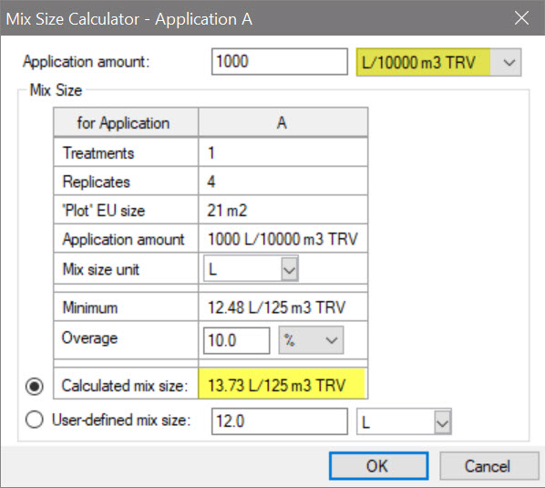
Tree/Crop Row Volume
Calculated Mix Size accounts for TRV:
New Application Amount unit for TRV
Mix Size = total mix to treat the calculated TRV of the crop (incl. overage) by treatment
3 of 3
2021.7
Notes:
#12179/12356

Slide 49
Study List
ARM Powered by GDM Solutions

Slide 50
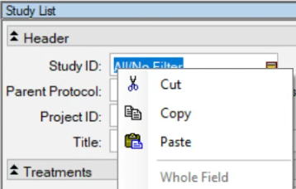
Study List
Two "quality of life" updates:
Filter fields now support cut/copy/paste of text (Right-click or keyboard shortcuts)
Filter is saved after opening and closing a study (within the current session)
2021.1
Notes:
#12071, 12034

Slide 51
Merge
ARM Powered by GDM Solutions

Slide 52
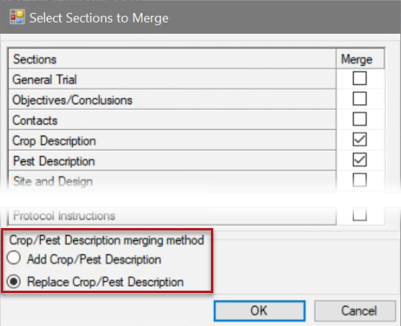
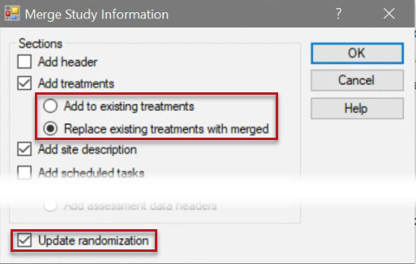
Merge
New option to Replace instead of Add to current study:
Treatments list
Crop and/or Pest information
Trial Map randomization
2021.1
Notes:
Feature in Action: start @ Trial Map, Trt Description (T1:"wrongTrt1",T2:"wrongTrt2"etc.). Plots not randomized. Then merge to update trt and randomization from tutorial file.
#12058

Slide 53
Custom Labels
ARM Powered by GDM Solutions

Slide 54
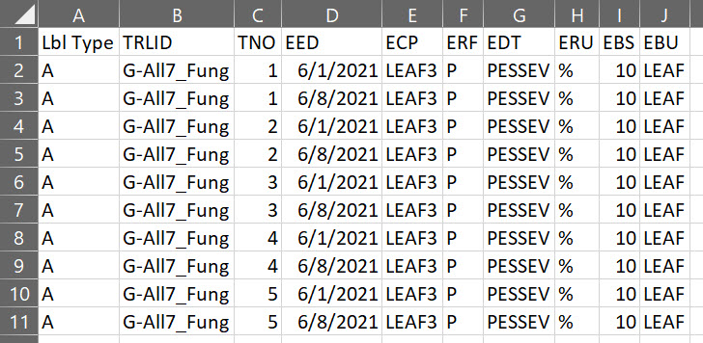
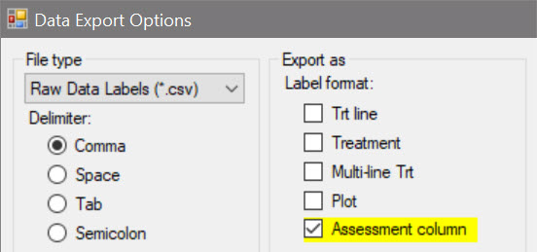
Raw Data Labels
Export assessment column information in Raw Data Label export
Generates 1 label per treatment, for each data column selected
You select the column details (header rows) to export
2021.7
Notes:
#12256
Does NOT generate a label for each plot.
Generates 1 label per treatment, for each data

Slide 55
Summary across Trials
ARM Powered by GDM Solutions

Slide 56
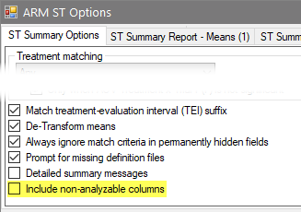
Non-analyzable columns
New option allows non-analyzable data columns to be included in ST summary
Previously these columns were automatically excluded from all summaries
1 of 2
2021.0
Notes:
# 11888
Some calculations are not analyzable in a single-trial analysis, but can be valid to include in multi-trial analysis!
Previously these kinds of columns were automatically excluded from any ST analysis, regardless of criteria.
Full list of ARM Action Codes affected: N, NM, THT, TTHT, TSO, TTAB, TTABR, TUPOC, TUPOCR, REL, RELR, RELS, RA, RA2, or ITAB.

Slide 57
Non-analyzable columns
Data column is non-analyzable when ARM Action Code…
specifies that the column is non-analyzable
calculates the same value across replicates ("per treatment")
2 of 2
2021.0
Notes:
# 11888
Some calculations are not analyzable in a single-trial analysis, but can be valid to include in multi-trial analysis!
Previously these kinds of columns were automatically excluded from any ST analysis, regardless of criteria.
Full list of ARM Action Codes affected: N, NM, THT, TTHT, TSO, TTAB, TTABR, TUPOC, TUPOCR, REL, RELR, RELS, RA, RA2, or ITAB.

