Slide 1
ARM 2024 Changes

Slide 2
2024.0

Slide 3
Assessment Editor
ARM Powered by GDM Solutions

Slide 4
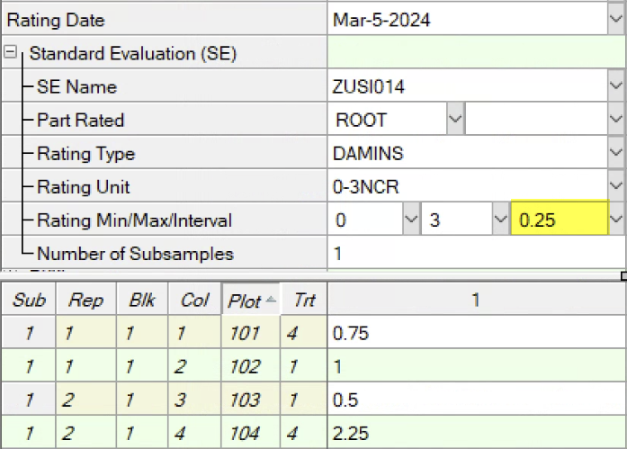
Rating Interval
Define numerical interval between valid assessment values
E.g. Interval=1 for whole numbers, 0.25 for values like 0.75, 1.25
1 of 2
2024.0

Slide 5
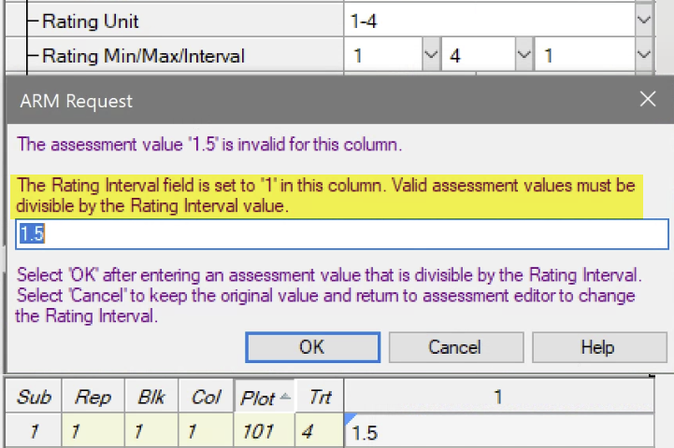
Rating Interval
ARM prompts if invalid data value is entered:
Intervals define rating shortcut buttons in ARM Mobile:
2 of 2
2024.0

Slide 6
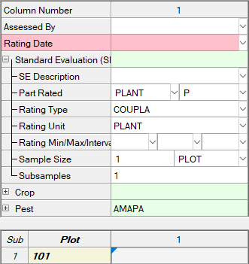
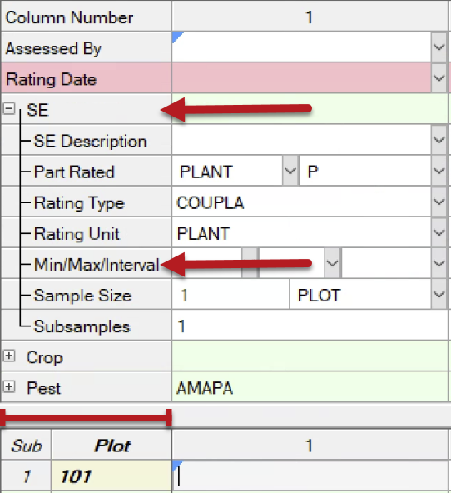
Tablet Data Entry mode
Reduced width of header prompts to fix more on the screen
Before
After
2024.0

Slide 7
Study List
ARM Powered by GDM Solutions

Slide 8
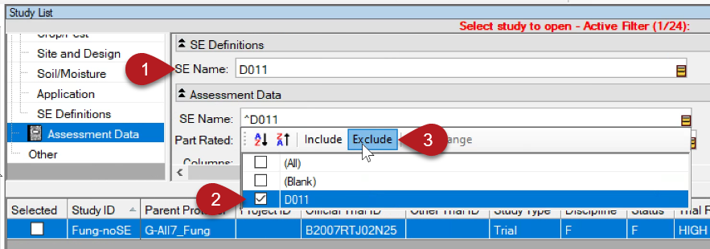
Study List
Added new fields to the Study List:
Trial Origin, SE Definitions – SE Name, Assessment Data – SE Name
Tip: Use both SE Name filters to find trials that did not use a particular SE:
2024.0

Slide 9
Site Description
ARM Powered by GDM Solutions

Slide 10
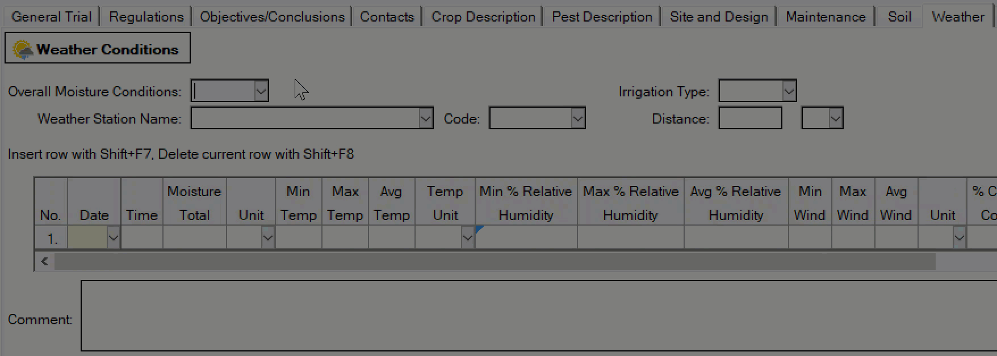
Editor View
Hide multiple fields at once within a Site Description table
Drag to highlight multiple columns/rows, then right-click > “Hide Current Field”
2024.0

Slide 11
Bug Fixes
ARM Powered by GDM Solutions

Slide 12
Impactful fixes
Fixed issue where box-whisker graph outliers may be beyond the Y-axis range, when the Y axis scale is set to Zero Origin.
Improved messaging when an image is corrupt or too large to add to the Profile or to sign a trial.
Fixed so trial columns that have a blank ARM Action Code are not forced into separate grand mean columns in ARM ST (Summary across Trials) add-in.
Changed so incompatible filename characters are not allowed in Protocol ID and Trial ID fields. These include: \ / : * ? < > | # % & $ ! ' @ + ` =
2024.0

