Slide 1
ARM 2025 Changes
Updates to ARM software in 2025

Slide 2
Site Description

Slide 3
Set As Default
Save values as default with “Default Entry” right-click menu
Defaults are inserted when creating or opening a study where the chosen field is empty
Remove existing default values using Clear Default command

Slide 4
Crop/Variety List
Added picklist for saving/selecting commonly used Crop+Variety details
To fill: enter all Crop details then click Crop/Variety List button to add new record to your list

Slide 5
Climate Zone (EU only)
ARM now auto-fills the Climate Zone when an EU Country is selected
For countries with multiple climate zones, auto-fill waits for State/Prov or County to be filled (e.g. Croatia or France)
Exception: When Site Type is set to a controlled environment, then “N/A” is auto-filled for Climate Zone

Slide 6
Study Rules

Slide 7
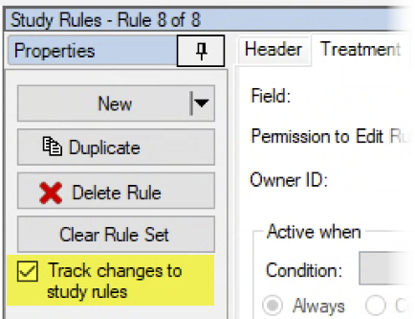
Track changes to Study Rules
New option logs changes to study rules in a trial
Tracks when rules are deleted or downgraded (e.g. Required to Recommended)
Select a Reason to click OK and proceed with the change or deletion
1 of 4

Slide 8
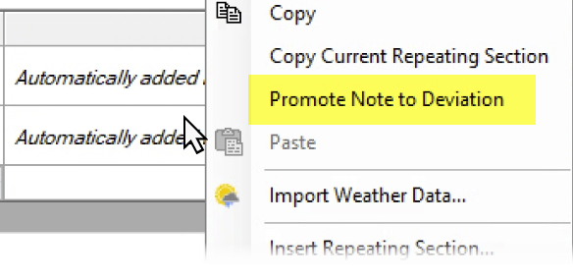
Track changes to Study Rules
The change and reason are logged as a Note in the trial
Right-click > Promote Note to Deviation creates a deviation record too
2 of 4

Slide 9
Track changes to Study Rules
Only the Protocol Owner can turn tracking on or off
Protocol Owner can also skip tracking of a particular rule change:
Note: this does not affect Permissions to Edit Rule functionality. Users must still have rights to make changes to rules in the first place.
3 of 4

Slide 10
Why Track changes to Study Rules?
Require documentation for departures from standard rules and requirements There may be a good reason the rule could not be followed, let us know!
Is the trial still valid? If critical rules were removed/changed, the trial may need to be repurposed
Provide feedback for future study rule sets What rules caused issues for trialists? Why are rules being removed? Etc.
4 of 4

