Slide 1
ARM 2026 Changes
Updates to ARM software in 2026

Slide 2
Site Description

Slide 3
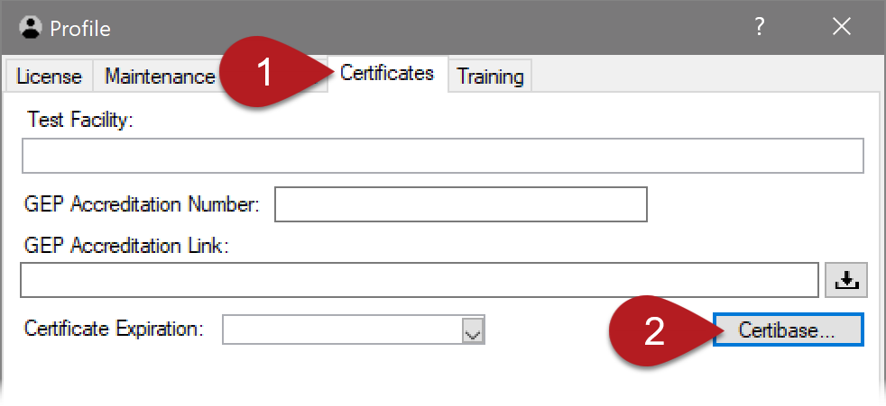
GEP Accreditation Certificate
Search the GEP Certificate Database System (Certibase) within ARM
to populate GEP Accreditation details (test facility and certificate)
Select Help > Profile > Certificates tab
Click on Certibase button
1 of 2

Slide 4
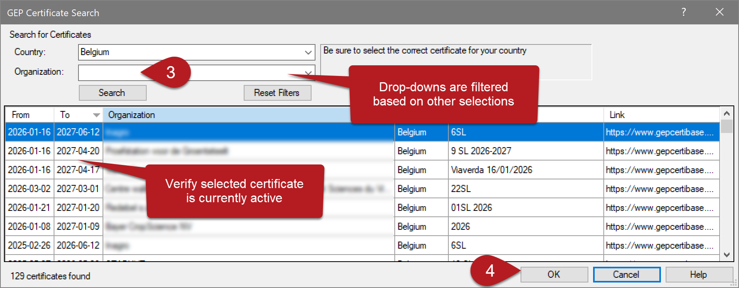
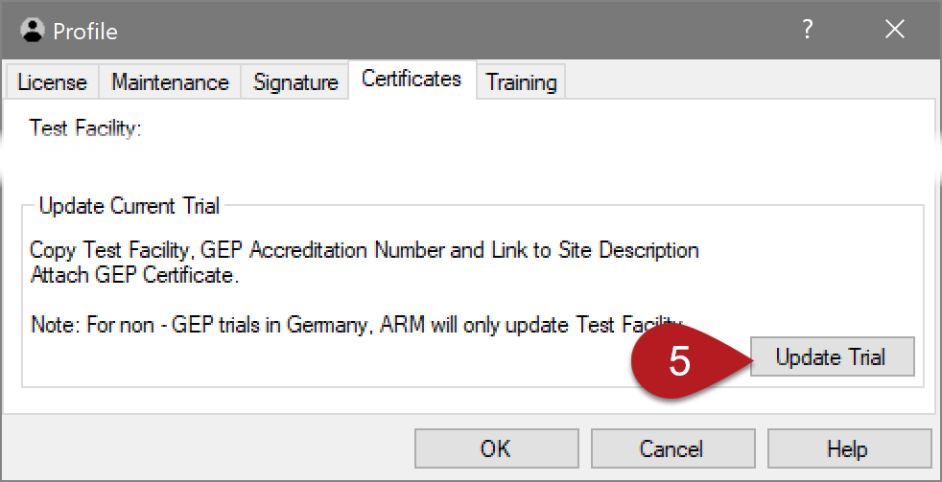
GEP Accreditation Certificate
Select Country and/or Organization
and click Search
Choose an active certificate
and click OK to save to Profile
Select Update Trial to copy selected
certificate details to current trial
2 of 2

Slide 5
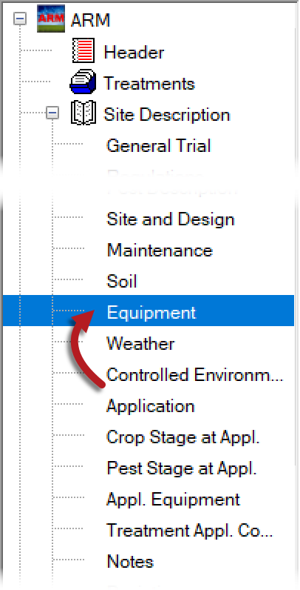
Equipment tab
Rearranged the list of sections to better place Equipment tab chronologically
Why? Equipment should be defined first,
and then those records can be linked
to the later sections
(e.g. Weather station or growth chamber)

