Slide 1
ARM 2020
Preview and Review
Notes:
Review new features added in the last year (versions 2019.x)
Then preview changes to come in the upcoming year (2020.x)

Slide 2
Import Weather Data
ARM Powered by GDM Solutions

Slide 3
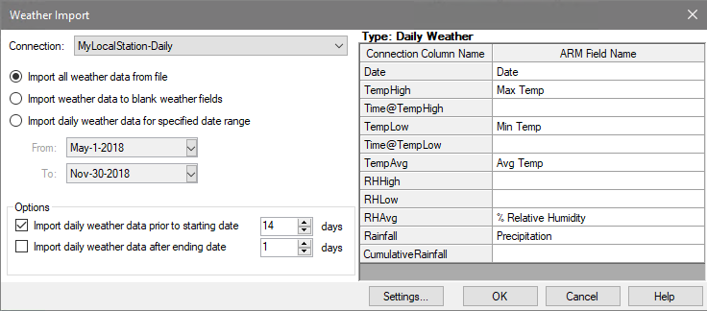
Import weather data
Import weather data from any weather source CSV file
Define connection between CSV and ARM fields
Specify what dates to import data from file
2019.3
Notes:
#10902

Slide 4
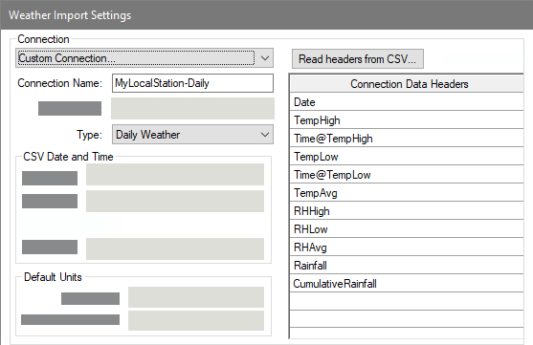
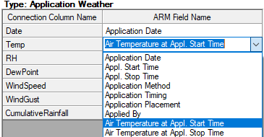
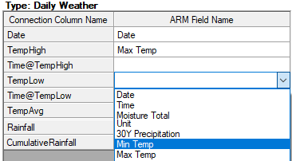
Import weather data
Feature in Action:
Define connection type and read column headings from CSV
Map CSV headings to ARM weather fields Hourly = Application; Daily = Weather table
2019.3
Notes:
#10902

Slide 5
Custom Labels
ARM Powered by GDM Solutions

Slide 6
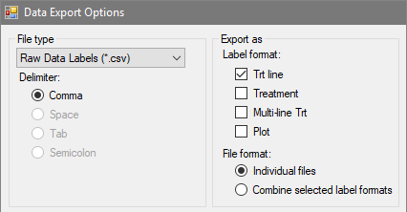
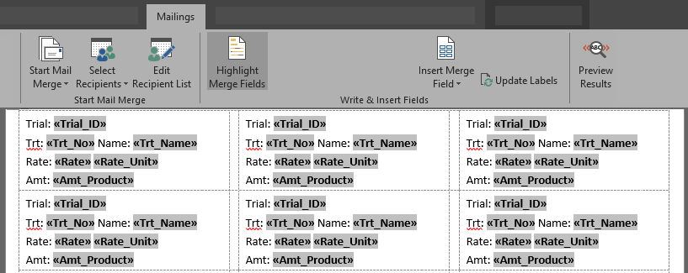
Custom Labels
Create custom labels by exporting treatment/plot information to .csv
Use Mail Merge in a word processor to create your own labels
View Tutorial Video
2019.3
Notes:
#10765

Slide 7
SE Definitions
ARM Powered by GDM Solutions

Slide 8
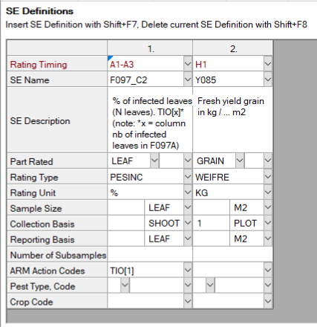
SE Definitions
Plan and define standard evaluations (SEs) and tasks to use in the study
Simpler than importing SEs from file into assessment data editor
Use Tools > 'Build Headers' and 'Build Tasks' to create the SEs and tasks defined in this tab
Multiple rating timings create columns and tasks for each timing code
Two-column SE F097_C2 times 3 rating timings A1-A3 = 6 total data columns
2019.1
Notes:
#10333

Slide 9
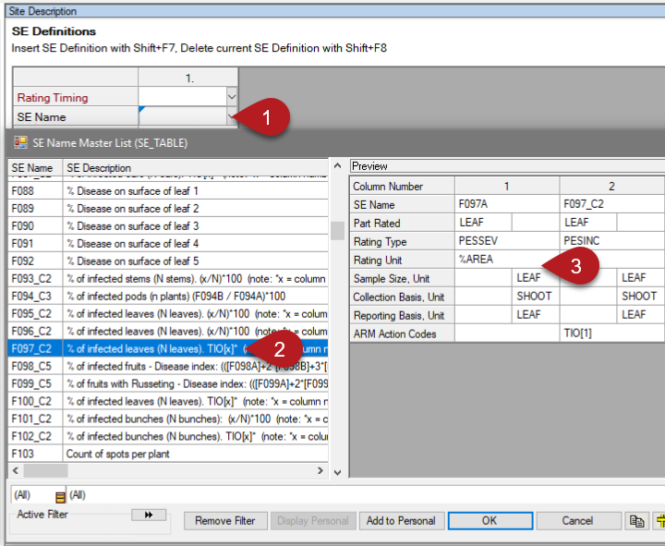
SE Definitions
Display SE Name list
Select an SE, can search/filter descriptions
Preview assessment columns defined in SE
Can also define tasks on this tab to add to Schedule editor
2019.1
Notes:
#10333

Slide 10
Column Diagnostics
ARM Powered by GDM Solutions

Slide 11
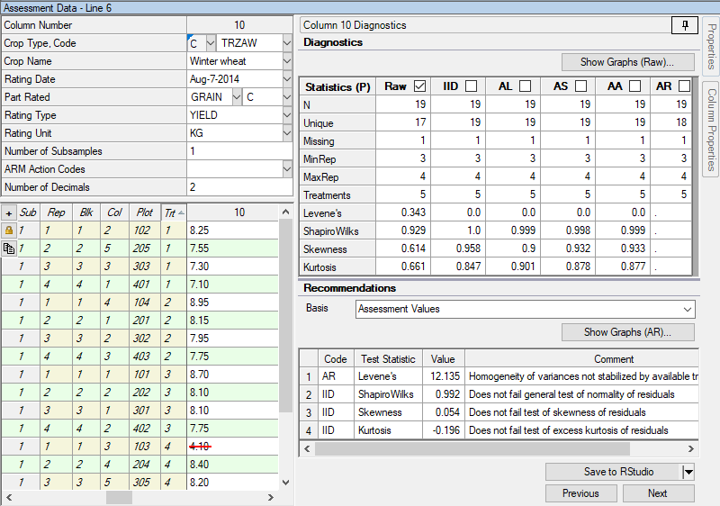
Column Diagnostics
New tool for reviewing data
Statistical tests for assumptions of AOV, run on residuals
ARM recommends actions from results
View diagnostic plots of data and residuals
Find outliers
2019.8
Notes:
#11145

Slide 12
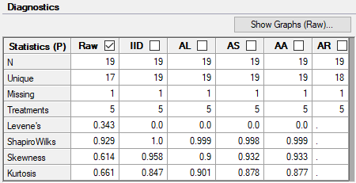
Column Diagnostics
Statistical tests for assumptions of AOV analysis
Levene's: homogeneity of variance
Shapiro-Wilk's: general test for normality
Skewness/Kurtosis: tests for normality
Tests performed on residuals, not raw data
Significant P value -> test fails, so assumption is not met
2019.8
Notes:
#11145

Slide 13
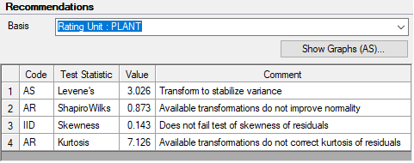
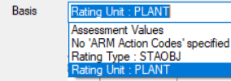
Column Diagnostics
Recommends actions for failed tests of AOV assumptions
Transformations
Non-parametric analysis
Suggestions based on assumed distribution of data
Determined from: Rating Type, Rating Unit, range of data values
2019.8
Notes:
#11145
Transforms:
AL: log
AS: square root
AA: arcsine square root
Distributions:
Poisson: "rare event" counts (# disease/insects) -> square root
Binomial: proportion/percentages -> arcsine

Slide 14
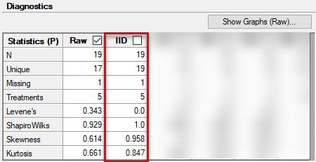
Column Diagnostics
IID - new ARM Action Code
Identically and Independently Distributed
Signifies that column meets all assumptions of AOV
A way to mark column as reviewed, but without any corrections required
AOV analysis is then run on the residuals (previously were run on raw data)
2019.8
Notes:
#11145

Slide 15
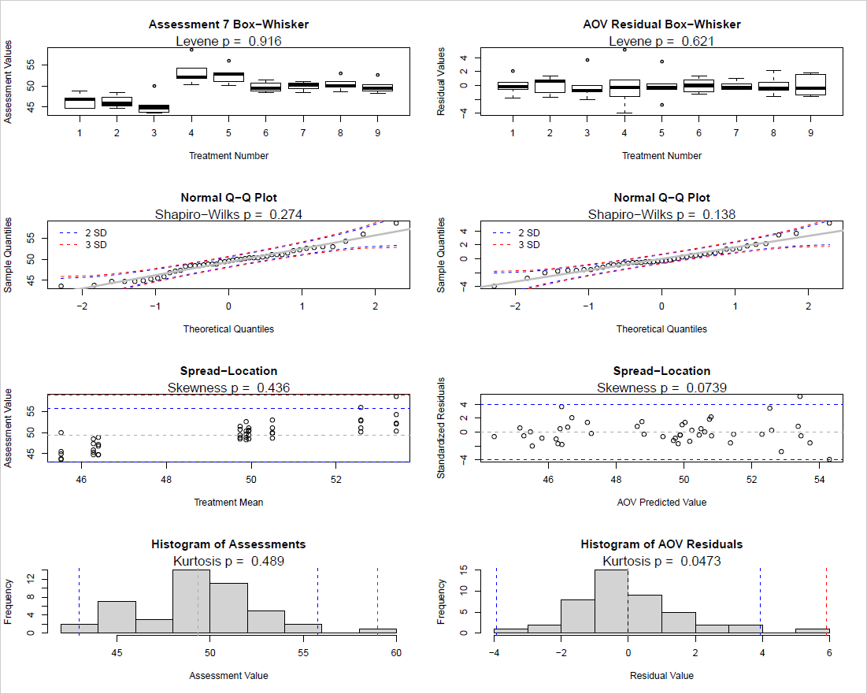
Column Diagnostics
View diagnostic plots:
Data vs. residuals
AOV residuals vs. transformed residuals
2019.8
Notes:
#11145

Slide 16
Column Diagnostics
Search for outliers
Search for outliers based on residuals
Calculates a studentized residual (accounts for number of observations)
(coming soon) Exclude all calculated outliers in the column
2019.8
Notes:
#11145

Slide 17
Non-Parametric Statistics
ARM Powered by GDM Solutions

Slide 18
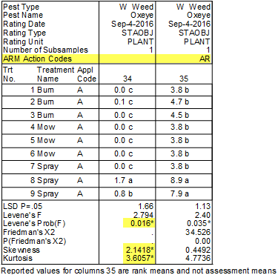
Non-parametric statistics
Relies on ranks to analyze data, instead of means and st. dev.
New ARM Action Code: AR (automatic rank transformation)
Rank the data points (Kruskal-Wallis or Friedman's test)
Perform mean comparison test on rank means (LSD)
Analysis included with other AOV columns
2019.8
Notes:
#11145
Col 10 has significant homogeneity of variance, cannot be fixed by data correction transformations. Run with non-parametric instead.
Rank analysis done based on experimental design:
CRD=Kruskal Wallis
RCB=Friedman's
All others=Aligned Rank Kruskal-Wallis

Slide 19
Why non-parametric???
ANOVA has assumptions that must be met
Otherwise results may not be valid
Non-parametric analysis does not have these restrictions
Use non-parametric when:
Data cannot be corrected to fit assumptions of AOV
Data is not real-valued, like counts or index scales
2019.8
Notes:
#11145
Assumptions of ANOVA:
Heterogeneity of variances
Normality of data
Independent samples
Q. Why don't we always use N.P. if don't have to worry about assumptions?
N.P. stats are generally less powerful than the AOV counterparts, so better to use AOV if assumptions are met

Slide 20
ARM 2019.x Changes
Additional enhancements

Slide 21
Site Description
ARM Powered by GDM Solutions

Slide 22
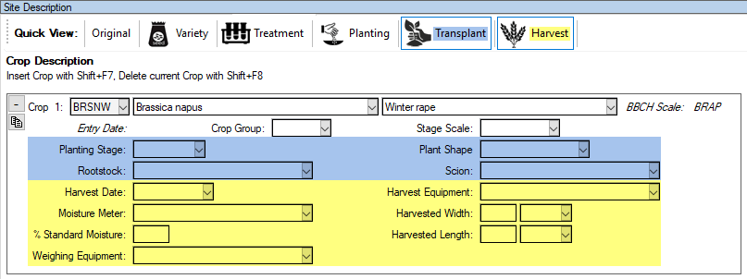
Quick View toolbar
Feature in Action:
Automatically filter visible Crop Description fields by task
Simplifies interface to view/enter only pertinent information
Multi-select to view fields from >1 task at a time
2019.3
Notes:
#10855

Slide 23
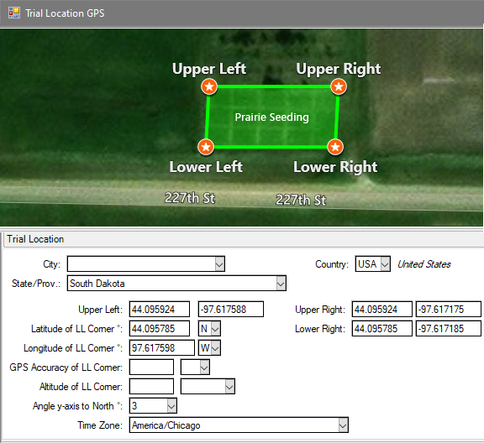
Trial Location GPS
Visually verify accuracy of trial GPS coordinates
Auto-fills Time Zone and Angle y-axis to North (Orientation) based on GPS coordinates
2019.8
Notes:
#11164

Slide 24
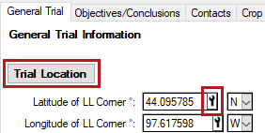
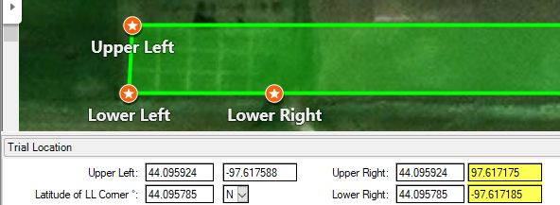
Trial Location GPS
Open from Tool icon in GPS field, or Trial Location button
Useful to catch errors in GPS coordinates entered!
2019.8
Notes:
…like forgetting a negative in the coordinate!!
#11164

Slide 25
Track Trial Progress
Why document trial progress?
Requested by sponsors.
Provides visibility and credibility to timely data entry.
Added new fields to track status and progress throughout the season.
2019.1
Notes:
These are read only.
After adding a Crop/Pest then it will add it after selecting either a Crop/Pest. This will disappear if the repeating crop/pest section is deleted. The date will also update if there is a change to either the crop/pest.
Implemented at the request of sponsors, to see when the trialist entered relevant information. This is documentation so that sponsors understand when data has been entered and have the ability to understand those CRO's who enter timely data throughout the season. Sponsors prefer data to be entered at the time so that accuracy is achieved as research is very expensive.
#10407

Slide 26
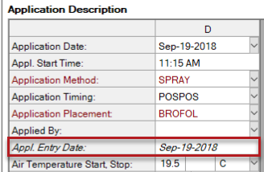
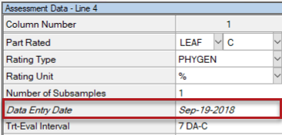
Track Trial Progress
Additional new fields to track status and progress throughout the season.
Application tab > Appl. Entry Date
Assessment Header > Data Entry Date
2019.1
Notes:
Same discussion as previous slide but now applies to the Application tab and Assessment data columns.
#10407

Slide 27
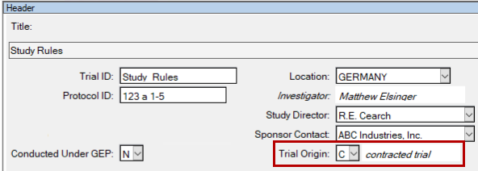
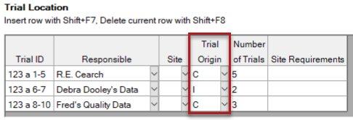
Trial Origin
Why track the trial origin?
Helps answer budget questions.
Valuable to the R&D division.
ID’s in-house, contracted or by a public institution trials.
Header editor > Trial Origin or,
Trial Establishment Guidelines > Trial location Table
2019.1
Notes:
Why? This is valuable information to an R & D division as they can assess whether the meaningful trials are in-house, contracted or by a public institution. Research division use this for budgeting purposes to help maximize the value to the research dollars spent.
Go to Header section.
Or, go to a Protocol > Trial Location table to see the option.
#10333

Slide 28
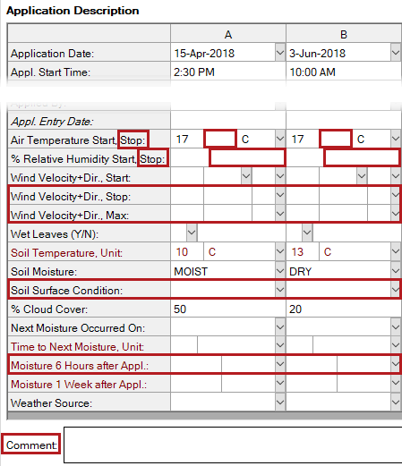
Application tab
New fields to document additional weather details at time of application:
'at stop time' variants of:
Air Temperature
% Relative Humidity
Wind Velocity + Direction
Soil Surface Condition
Moisture 6 Hours after Appl
Comment
2019.1
Notes:
Provide more details about history of the trial site
#10333 and 10690

Slide 29
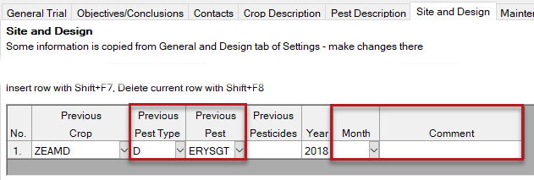
Previous Crops
Site and Design > Previous Crops table
Additional new fields to document previous conditions at the trial site.
Previous Pest
Month (that crop/pest was present)
Comment
2019.1
Notes:
Provide more details about history of the trial site
#10333 and 10690

Slide 30
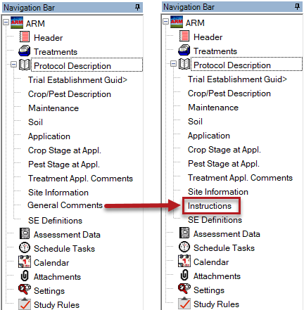
Protocol Comments
Protocol Comments tab renamed to Instructions
Protocol Description: from General Comments to Instructions
Site Description: from Protocol Comments to Protocol Instructions
2019.1
Notes:
FYI
#10333

Slide 31
Trial Map
ARM Powered by GDM Solutions

Slide 32
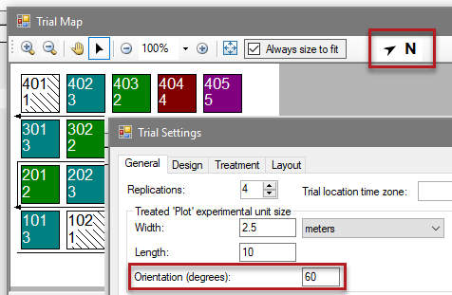
Orientation
Display orientation from North on Trial Map
Orientation entered in General Settings
Number of degrees from North for the left edge of the trial
2019.4
Notes:
#10961

Slide 33
Study Rules
ARM Powered by GDM Solutions

Slide 34
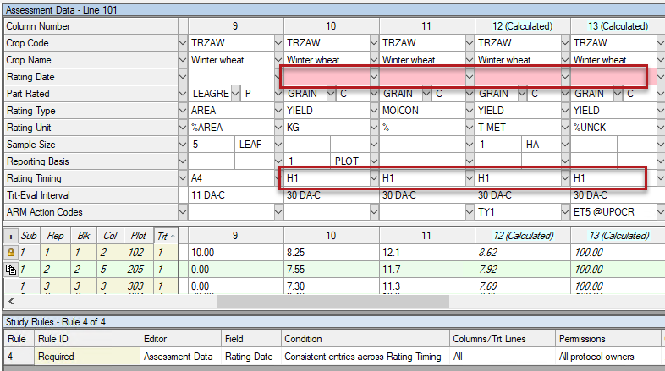
Consistent entries across Rating Timing
New study rule
Auto-fills and maintains same entry in chosen field, across the same Rating Timing value
2019.4
Notes:
#11047

Slide 35
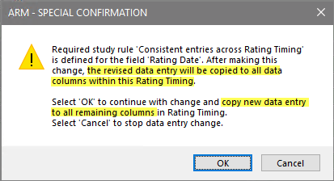
Consistent entries across Rating Timing
Feature in Action:
Useful for fields that cannot differ at a single Rating Timing
E.g. Rating Date, Crop information
2019.4
Notes:
#11047

Slide 36
Permissions
The default permissions is now "Everyone in my company" for new rules
Easier for colleagues to also edit study rules, not just the study owner
Note: ARM remembers the last Permissions chosen when adding new rules, so this default applies mainly to new installations
2019.2
Notes:
#10771

Slide 37
Print Reports
ARM Powered by GDM Solutions

Slide 38
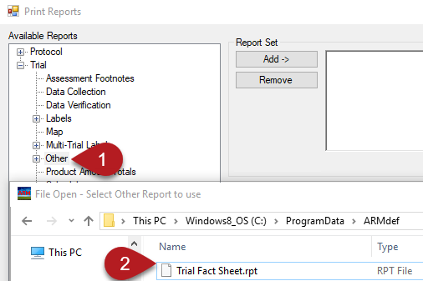
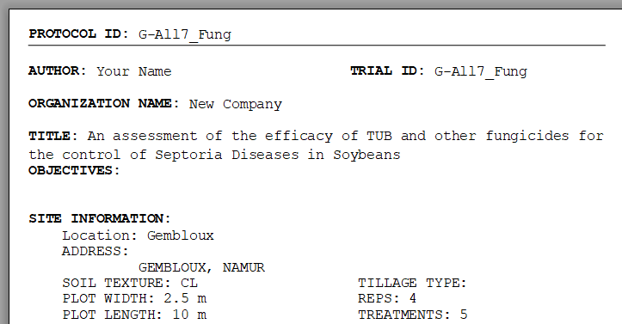
Trial Fact Sheet
New report provides a trial synopsis
Useful for trial tours, overview
Select 'Other' in Available Reports
Load Trial Fact Sheet.rpt from ARMdef folder
2019.4
Notes:
#10957

Slide 39
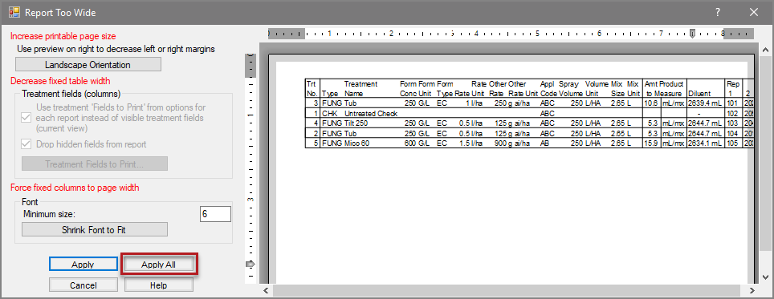
Report Too Wide
Apply All button added to apply changes to all pages in report.
Previously dialog appeared for every page.
2019.4
Notes:
#11054

Slide 40
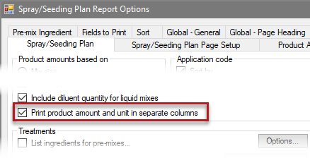
Spray/Seeding Plan
Added option to print product amounts and units in separate columns.
Useful when printing to Excel, so amounts are in a separate column.
2019.3
Notes:
#10843

Slide 41
ARM Window
ARM Powered by GDM Solutions

Slide 42
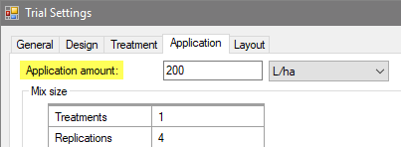
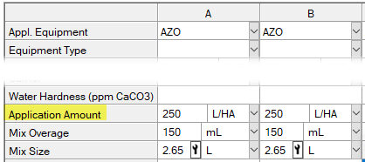
Spray Volume
Renamed to Application Amount to be more generic for all treatment/application types
2019.4
Notes:
#10995

Slide 43
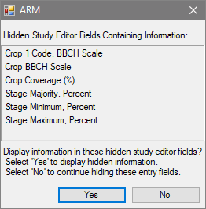
Hidden fields with info
Automatically show fields that are hidden from view, but contain information
Eliminates prompt when opening a study
Ensures that all information is conveyed when opening a file for the first time
2019.4
Notes:
#11035

Slide 44
Toolbar
Improved the appearance of toolbar buttons
Cleaned up some missing pixels so we can actually tell what the image is supposed to be!
2019.3
Notes:
#10863

Slide 45
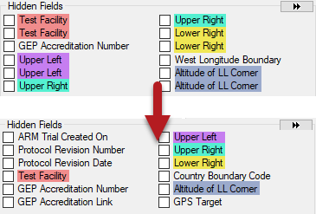
Properties Panel
Field pairs display as single checkbox in Hidden Fields list
Value + Unit fields
Code + Description fields
Treatments, Protocol/Site Description, Assessment Data editors
2019.3
Notes:
#10850

Slide 46
Hidden Fields
Do not scroll back to the top of the list when selecting a field.
Now much easier to make multiple fields visible at a time
Before: After:
2019.2
Notes:
#10766

Slide 47
Display Options
ARM Powered by GDM Solutions

Slide 48
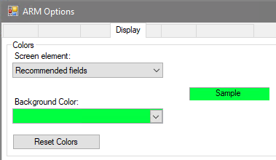
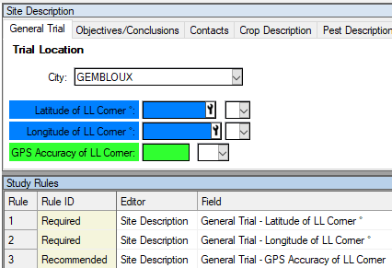
Change rule colors
Change the background color of required and recommend fields
Tools > Options > Display tab > Colors
2019.4
Notes:
#10951

Slide 49
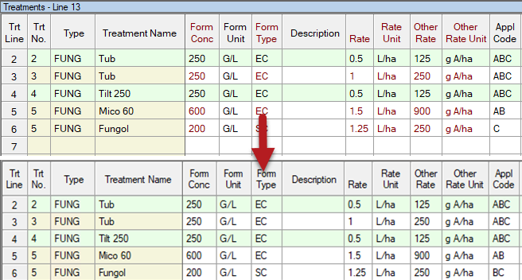
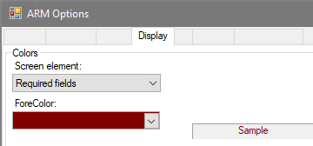
Font color fix
Font Color option for Required fields now only applies to always-required fields (found in some customizations)
Previously other field pairs were also colored
2019.4
Notes:
#10951

Slide 50
Migrate Settings
ARM Powered by GDM Solutions

Slide 51
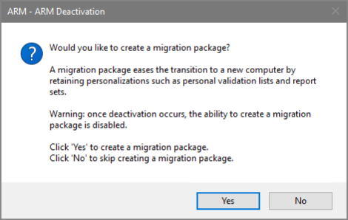
Migrate Settings
Copy settings when moving to a new PC
Copy personal lists, report sets, ARM settings to new computer
What's new?
Prompt to create package before deactivating the old PC.
2019.1
Notes:
#10270

Slide 52
ARM 2020 Preview

Slide 53
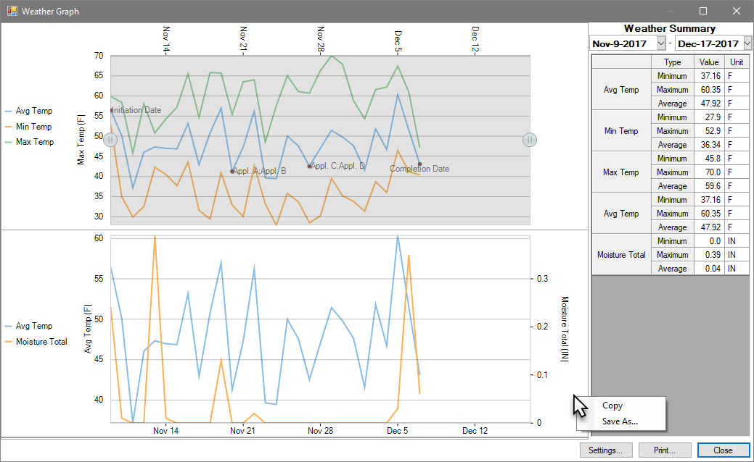
Graph Weather Data
3 columns of data per graph, plot up to 4 graphs at a time
Plot on left and right Y-axis for mixed units
Interactive date range selector
Summarize data in range
2020.0
Notes:
#11305

Slide 54
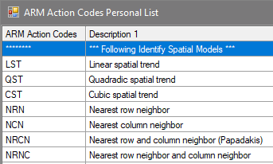
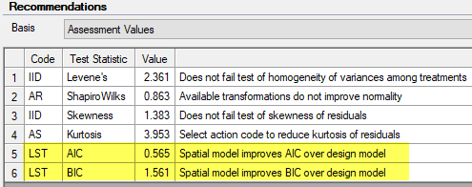
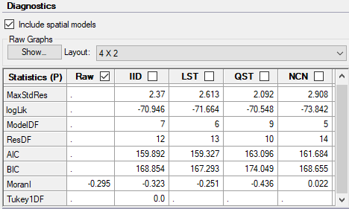
Column Diagnostics
Spatial models included in analysis
New diagnostic statistics added
2020.0
Notes:
#11329

Slide 55
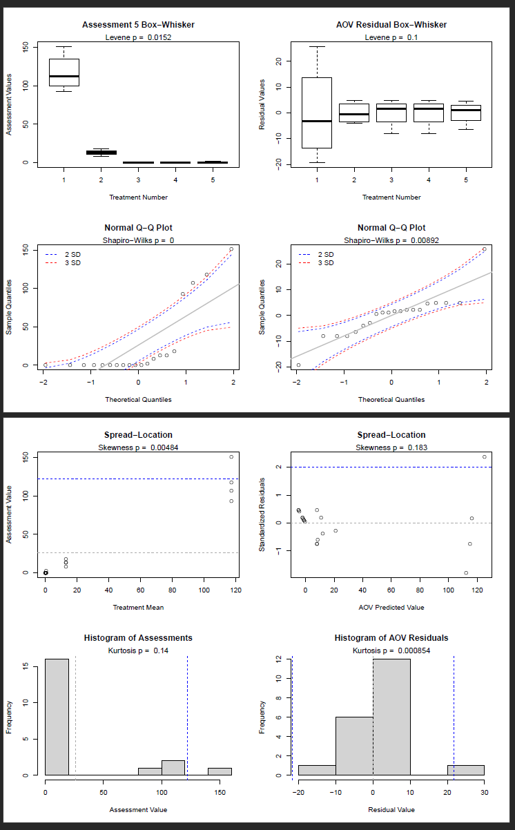
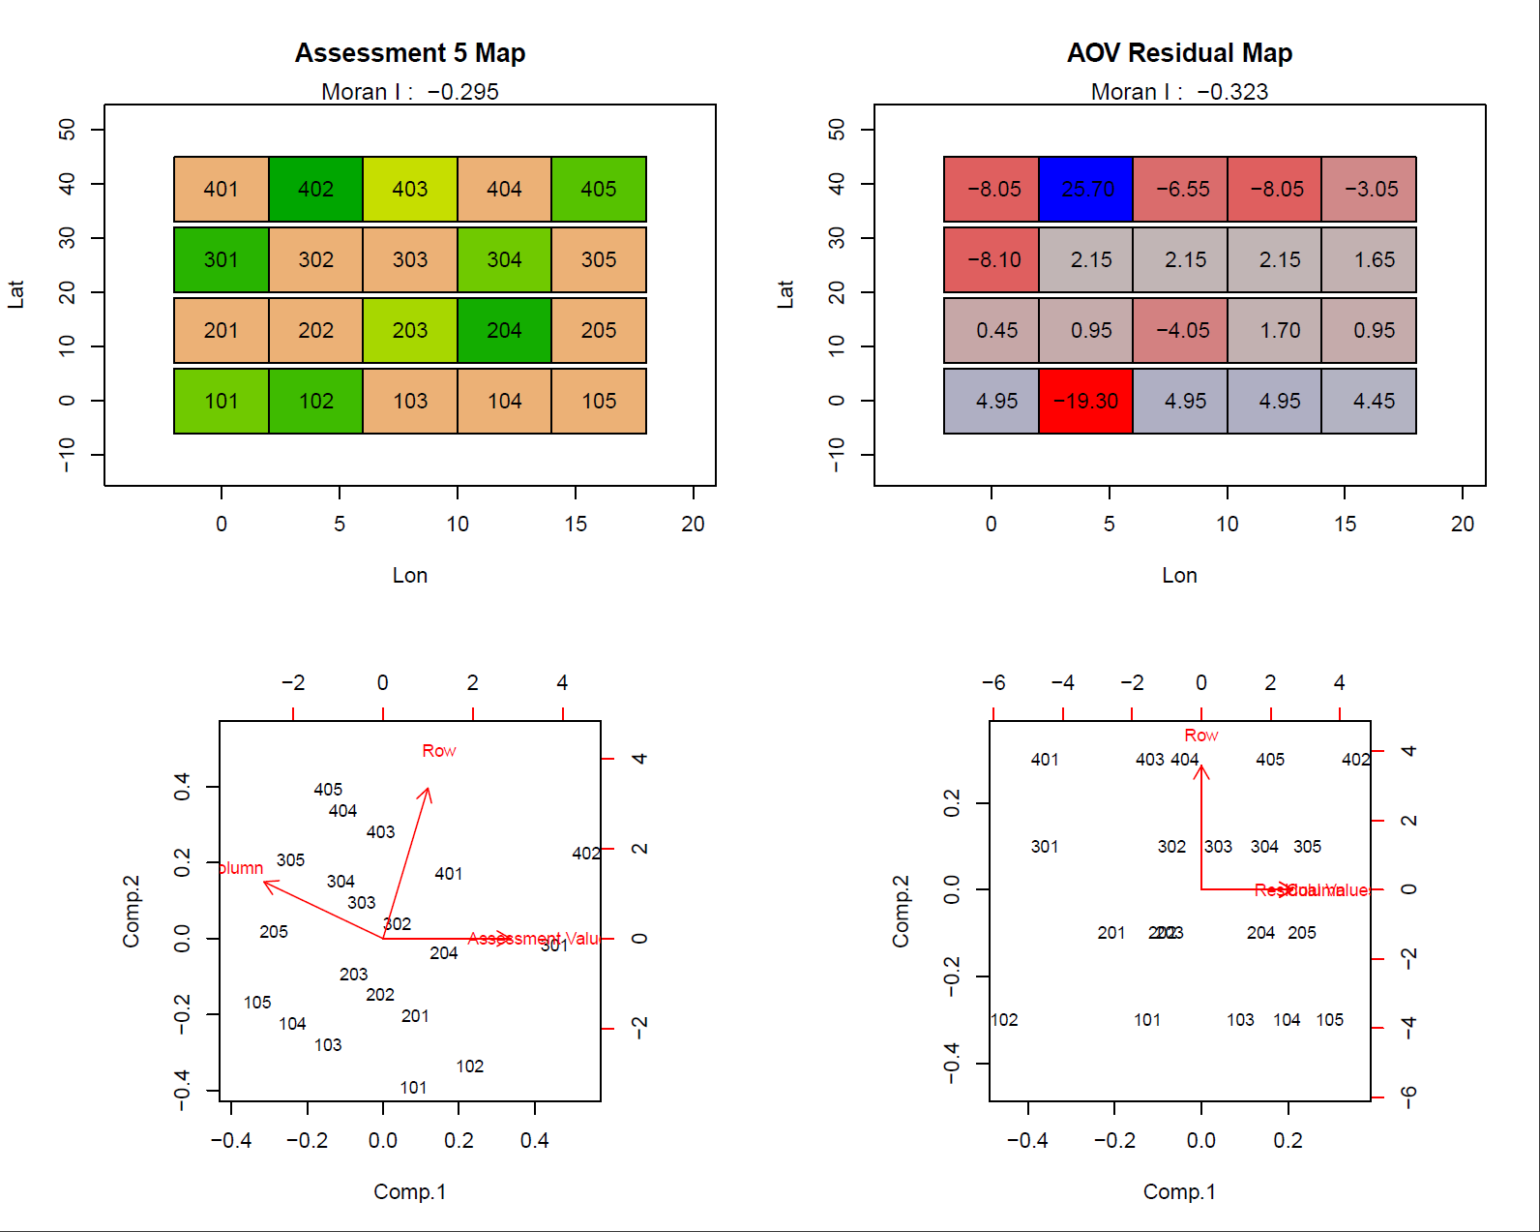
Column Diagnostics
Change the number of diagnostic graphs per page, to improve readability
Two new graphs for spatial models
2020.0
Notes:
#11329

Slide 56
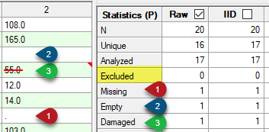
*Excluded plots
*Not available in prerelease
New property for experimental units: Excluded
Existing Damaged flag not appropriate in all situations (e.g. outliers)
2020.x

Slide 57
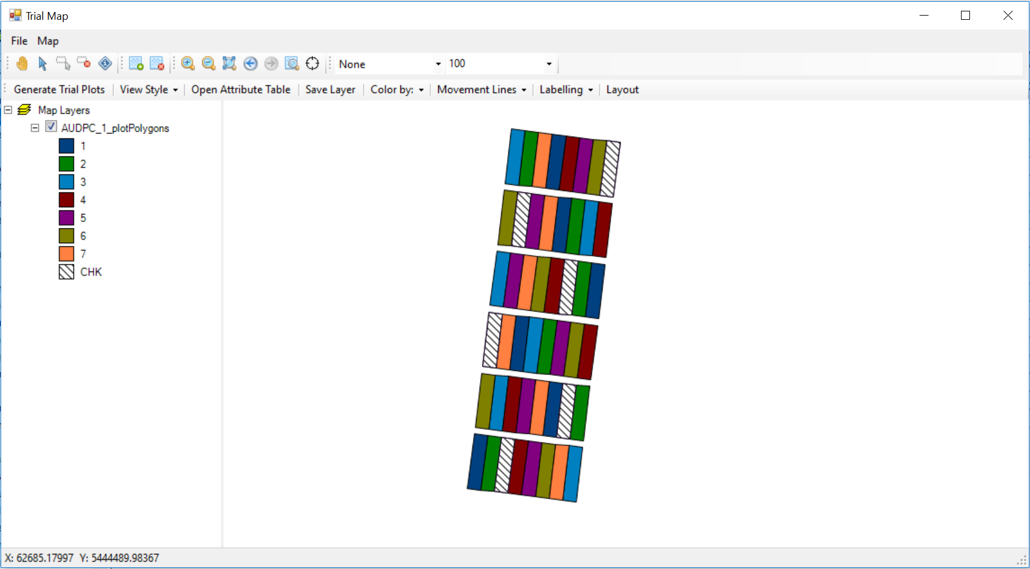
*Trial Map Layers
*Not available in prerelease
2020.x

Slide 58
*Trial Map Layers
*Not available in prerelease
2020.x

Slide 59
*Trial Map Layers
*Not available in prerelease
2020.x
Notes:
Attributes table

Slide 60
*Trial Map Layers
*Not available in prerelease
2020.x
Notes:
Movement arrows

Slide 61
*Trial Map Layers
*Not available in prerelease
2020.x
Notes:
Square view with Labels

Slide 62
*Trial Map Layers
*Not available in prerelease
2020.x
Notes:
Layout tool

Slide 63
*Trial Map Layers
*Not available in prerelease
The layout tool can adjust the actual location of the plots or change the order of the plots or the replicates.
Original Replicate Order
Adjusted Replicate Order
2020.x
Notes:
Layout tool

