Slide 1
Statistics in ARM
Prepare & analyze trial data
Notes:
In this session, we introduce statistics for research – specifically geared towards the tools and analysis offered within ARM.
We will discuss analysis of variance, mean comparison tests, and the assumptions of AOV to watch out for. This lays the foundation for the various data management and analysis features that can be used in ARM.

Slide 2

Research Basics
Determine if treatments of interest perform the same
  Treatments: Products, formulations, rates
  Perform: effectiveness, crop safety, cost
Research to gather observations
  aka Assessments or Ratings
Are observed differences REAL or due to random CHANCE?
Notes:
The goal of research is often to determine whether treatments of interest perform differently.
*The choice of treatments could be different products, different formulations, or different rates of application. We want to know if those treatments can be distinguished from one other, in their effectiveness, safety to the crop, or cost (sometimes the hope is that performance is indistinguishable, if you product is cheaper!)
*Research trials are then performed to obtain observations of treatment performance (we call them assessments or ratings).
*But the question is, are the observed differences due to the treatments, or due to random chance? This is where statistics come in, namely Analysis of Variance.

Slide 3
Step 1:
Data Confirmation
Notes:
You should not immediately jump to the analysis after recording data. Data Confirmation is important to catch outliers and issues with the assessment, to ensure accuracy before analysis begins.

Slide 4

Before you analyze data…
Analysis is dependent on data accuracy
  Review rating immediately, at trial site
  Outliers can exist, typos should not!
  Decide acceptable range of values (before)
Notes:
The best way to ensure accuracy is by reviewing the assessment immediately afterwards, while still at the trial site. This way, any irregular values can be investigated and resolved. If you wait to input and review the data back in the office, these irregularities can only be ignored in the analysis – causing a loss in statistical power! We will look at tools in ARM for this step, in a moment.
*The issues we are looking for may sometimes just be a typo from data entry. Or it could be an outlier, which is an observation outside the normal or expected distribution.
*Another tip for data accuracy: identify an acceptable range of values before the assessment is taken. Extreme values may then stand out during notetaking, cutting down on surprises at the end review.
Let’s take a look at what tools we have in ARM for this process…

Slide 5
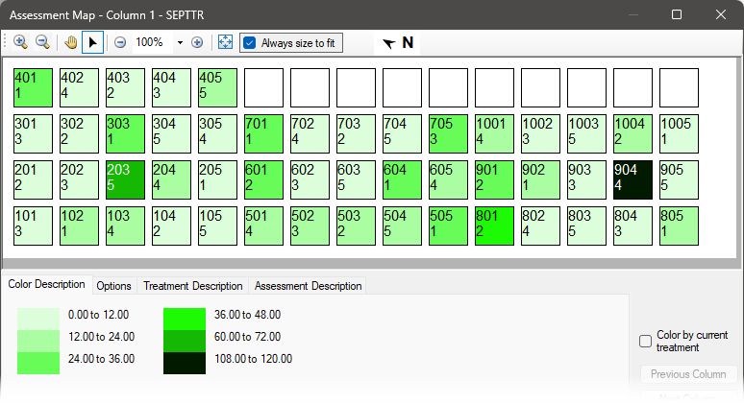
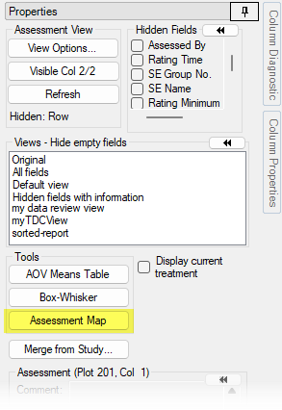
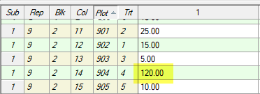
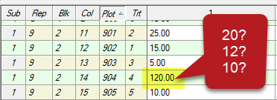
Assessment Map
Notes:
The primary tool for confirming data is the Assessment Map, which can be found on the Properties Panel at the right side of the Assessment editor, in the Tools section.
*This is a “heat map” to visualize the selected assessment column. The colors are based on the smallest and largest recorded values in that column. This can make it easy to spot extreme values … and in this case plot 904 really stands out as much larger than all of the other recorded values.
*If we investigate the actual values, we see that we have 120 … that’s not even possible because this assessment is % area of leaves that are diseased! Clearly this is a typo, but what can we do?
*After all, it could be a 20, or a 10, or even a 12. This is a reason why this review should occur while still at the trial site, so we can simply return to the plot and ensure the correct value is recorded.
Otherwise, if this data was written down and entered a week later during the next rainy day, then there isn’t anything we can do except to throw the value away. Not only is that a missed opportunity, it negatively impacts the statistical power we will have to draw conclusions in the analysis!

Slide 6
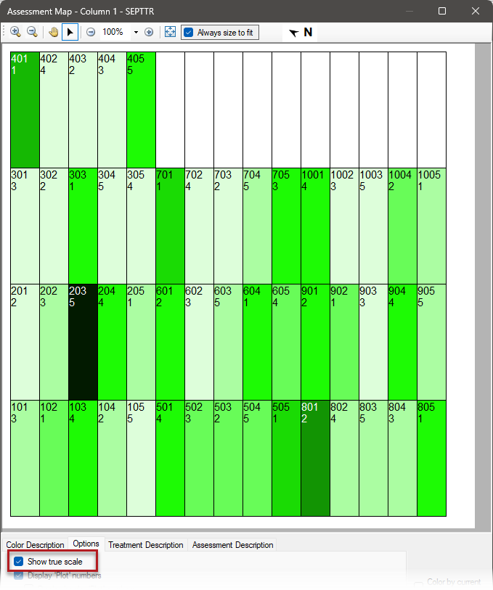
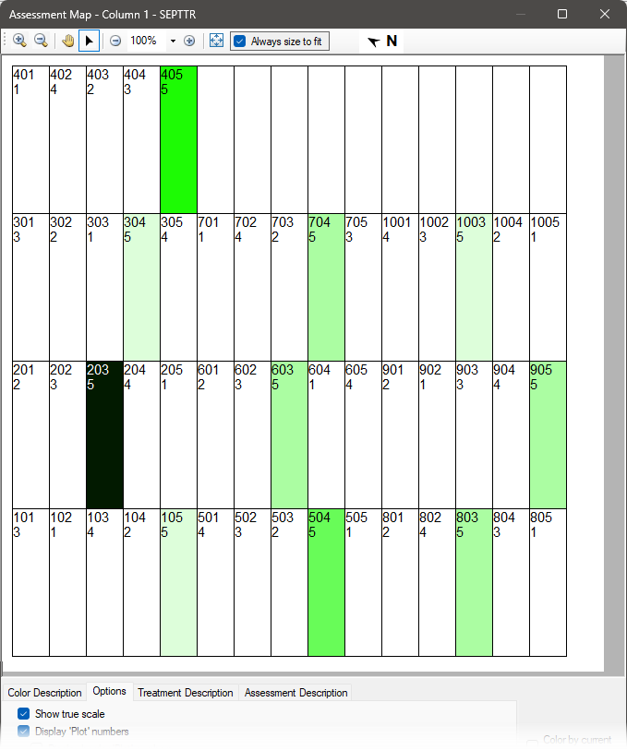
Notes:
Let’s say that we can confirm that it’s supposed to be 20 … we can adjust the value and then generate an updated map.
*Here I’ve selected the “Show true scale” option, so ARM draws the plots according to the plot and alley dimensions in the Trial Settings. This gives us an accurate spatial visualization of the assessment.
*You can also click on a single plot, and only that treatment is colored – to compare the product’s consistency across replicates.

Slide 7
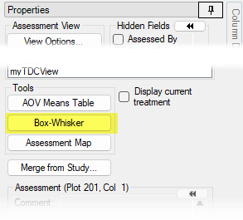
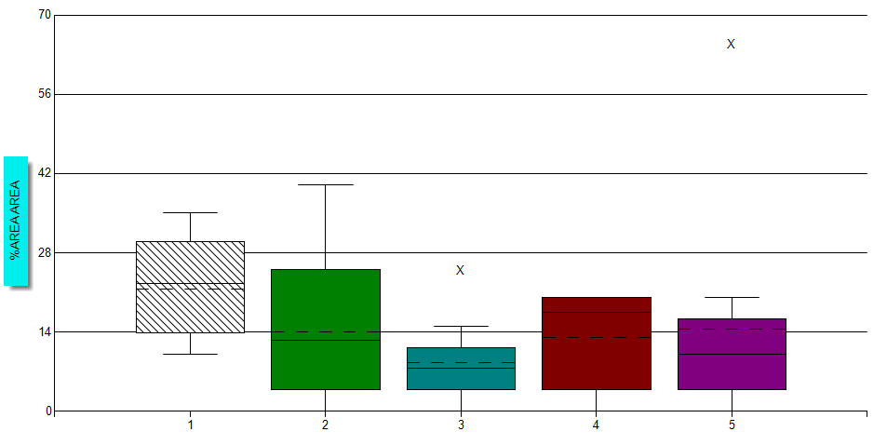

Box-Whisker
Box: 25/75 percentile
Mean: Dashed line
Median: Solid line
Outlier: 1.5 * box ht.
Notes:
Another tool we have is the Box-Whisker graph, found on the same Tools section of the Properties panel.
*Each treatment has a box and “whiskers”… the box is calculated from the 25th and 75th percentile of treatment values. The whiskers extend out to all other non-outlier values.
Box height gives a sense of variability within that treatment – a taller box means more variation. (We will use that concept later on as well…)
*The box is centered around the median, which is the 50th percentile (smack dab in the middle). The mean is the dashed line within the box.
You can see skewness when there is a difference between the 2 lines. For example, treatment 4 has a high median “waist” so there is a low value pulling down the mean. Vice-versa with treatment 5!
*Outliers are calculated by taking the height of the box, multiplied by 1.5. If you hover over the X in ARM, it will show what Plot number that outlier is.
Let’s take a closer look at outliers…

Slide 8
Outliers
Un-usual data does not mean un-usable data!
Don’t throw out all calculated outliers automatically
  Does this data fairly represent the trial and its objectives?
  Did an external force affect this plot disproportionately?
  Is this value within a reasonable range of outcomes?
Notes:
The key with outliers is that Un-usual data does not mean un-use-able data, so extreme values should not blindly be thrown out without some thought.
*This is where the trialist’s expertise gets to shine! Things to consider when deciding whether a value should be excluded or kept:
* - Does this data (still) fairly represent the trial and its objectives?
- Did an external force affect this plot disproportionately?
- Is the recorded value within a reasonable range of outcomes?
This is yet another reason to be confirming the data before you’ve left the trial site!

Slide 9
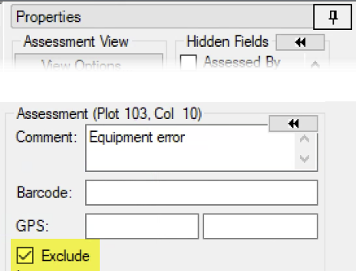
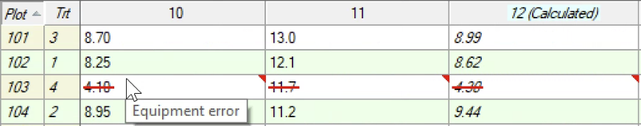
Exclude Data Points
Remove data points from analysis
Retain the documentation of the rating value
Notes:
If you do decide to remove the value,
*use the Exclude checkbox on the Properties panel to the right. This preserves the recorded value, yet ARM will ignore the value and treat the plot as if it was a missing data point when performing the analysis.

Slide 10
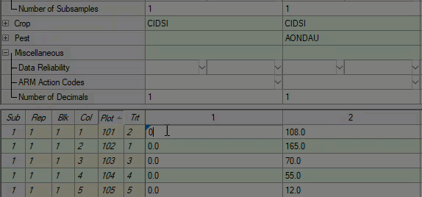
Data Column Reliability
Communicate what data to use in summaries
  Exclude = conclusions should not be made from this rating
  Good = conclusions can be made from this rating
  Best = conclusions can be made, prioritized over related ratings
Notes:
One final step for data confirmation is to classify how useful the assessments will be for summaries. This is the perfect time for this step, because the data has been inspected but we are not yet biased by any statistical conclusions.
*The Data Reliability field, in the Miscellaneous section of the header, is the best place to record this. But ARM has shortcut buttons next to the column number to quickly make this designation, as you can see in the video.
*There are 3 levels to choose from. The Red X means that conclusions should not be made from this rating. This could happen for several reasons; maybe there was just no pest pressure or nothing was happening yet in the trial. This doesn’t mean the data is wrong or bad, just that there is no value in using this data in a summary. Or if there are too many missing plots or a replicate had to be thrown out, this is a clear way to communicate that there are issues, from a summary standpoint.
*The Green checkmark means there are no such concerns about the data, and the column should be used for summaries.
*Finally, the gold star can be used to denote “the best” assessments for a summary. This isn’t necessarily to show the best outcome you were hoping for, but the rating which best illustrates the conclusions that can be drawn from the study. It’s especially helpful for repeat assessments, to mark the one in a series that stands out the most.
Or, a more casual definition that I like to give: if you can only graph 1 column from this trial, the one with the star is the one to look at!

Slide 11
Step 2:
Data Review
Notes:
Next, let’s review the data to prepare for analysis.

Slide 12

Analysis of Variance
Variance ~ how spread out the data is
Break down observed variance into causes:
  Controlled (treatments, blocking)
  Uncontrolled (experimental error)
Observed response =
overall mean + controlled effects + uncontrolled effects
Notes:
To set the stage, let’s first take a glance at our end goal: the Analysis of Variance (or AOV).
*Statistical variance is a measure of how “spread out” the data is about its mean. The goal of AOV is to dissect the variability in the recorded assessments, to understand whether the differences we have observed between treatments is due to the treatment itself, or just by random chance.
*There is controlled variability that the researcher had a hand in, from the treatment and blocking structure. Then everything we cannot control is called the experimental error.
*The overall approach is to consider that the observed response has three components: the “baseline” response if nothing had occurred in the trial, the effect that the treatments and blocking specifically had, and the effect of random influences too.
In order to draw conclusions about the treatment effects, we want to estimate what the random/uncontrolled effects are. To do this, we’re going to need to make some assumptions about their behavior…

Slide 13
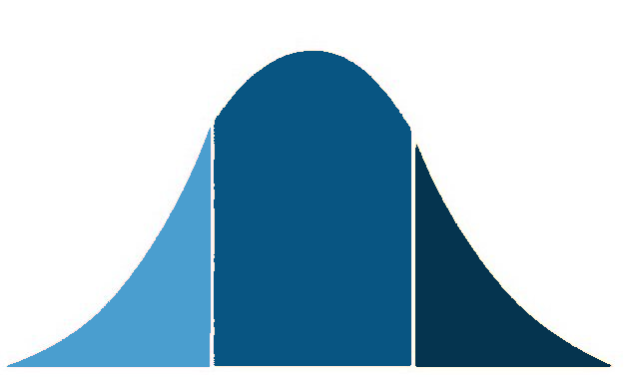
Assumptions of ANOVA
Homogeneity of variance
  Test: Levene’s/Bartlett’s & box-whisker
Normal distribution
  Test: Skewness, Kurtosis, Shapiro-Wilks
Additivity of effects
Independence of errors
  Tool: Assessment heat map
Notes:
So what are these assumptions?
*The first is homogeneity of variance, that the variances of the different treatments are approximately equal. If a treatment is much more variable (or much less variable) than the others, the analysis will not work. So to determine if this is the case, we can look at a box-whisker graph and run a test for homogeneity of variance – Levene’s is generally chosen but Bartlett’s is also an option.
*The next assumption is that the distribution of errors is normal, or bell-shaped. If we have this and equal variances, then the math can “do its thing” because we can calculate a reasonable guess for the amount of error based on the standard bell-shaped curve. Tests for this include Skewness, Kurtosis, and Shapiro-Wilks.
*Another assumption is “additivity of effects” – specifically of treatment and block effects in the typical RCB design. For example, the effects of treatments such as insecticide or fungal attack are likely to be multiplicative on the population count, affecting a proportion of the insect population. So perhaps the most suitable assessment to analyze would be a “percent of untreated” calculation instead of raw counts to gauge efficacy.
*Finally, the last assumption is independence of errors, that one assessments does not directly impact the next or previous value. This is harder to test for, but generally is not an issue; the biggest thing here is to not introduce bias in the assessment, like edge effects or subjective ratings being influenced, etc. The assessment map may be useful to detect some of these potential issues.

Slide 14
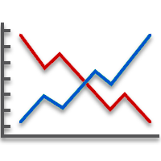
Fail to meet assumptions?
Data correction transformations
  Log, Square Root, Arcsine
Spatial models (when blocking fails)
  Trend, Nearest neighbor
Non-parametric statistics
  Rank-based instead of means
Notes:
What happens if these assumptions are not met? We cannot rely on the results, unless we take alternative action.
*There are data correction transformations, designed to correct the underlying distribution of the data (and thus the error) without affecting the results.
Log -> counts of things occur in clusters (log-normal distr)
Sq Rt -> counts of things occur at random/rarely (Poisson distr)
Arcsine -> %age (binomial distribution)
*Spatial models try to recover information about hidden variables across the field. There are 3 Trend and 4 Nearest Neighbor models that can be used in ARM, but are typically only used when the blocking design fails.
*Non-parametric statistics throw out AOV & its assumptions, and instead analyze the data by ranking the assessment values. A mean comparison test can still be run on the mean of those ranks.

Slide 15
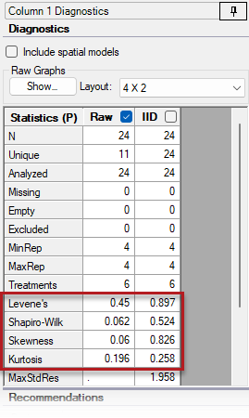
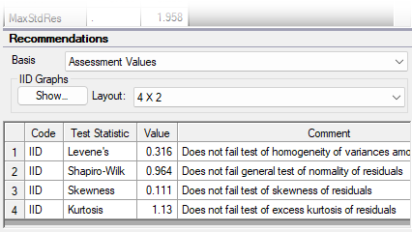
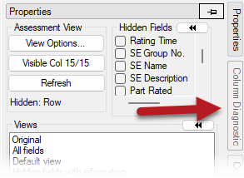
Column Diagnostics
Notes:
The main tool in ARM used for Data Review is the Column Diagnostics panel, which is a separate from the Properties panel at the right of the Assessment editor.
*The top panel calculates a variety of “stats” about the column, like the number of values, how many are analyzed (compared to how many are missing or excluded, etc.) Then we have the statistical tests for AOV assumptions; the reported values are P-values, so significant values indicate there is a problem with that assumption. There is a column in this table for each potential course of action or data correction. Raw is the regular data points, and IID is the tests run on the residuals. The modern statistical approach is to use the residuals for making decisions on what action to take.
*The next panel displays a Recommendation for each of the four statistical tests. The “IID” code does not actually change anything in the analysis, but instead is a way to mark the column as reviewed but no changes are required. Which is the case for all 4 tests in this assessment, so no corrective action is needed!

Slide 16
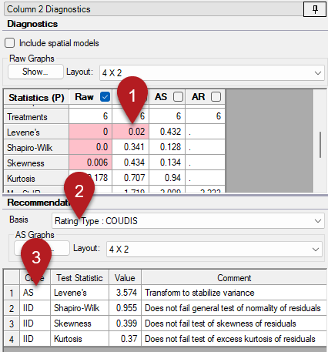
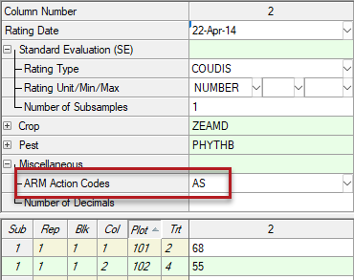

Column Diagnostics
Notes:
Moving to another column, we have an example where an action is necessary, because Levene’s test is significant. Before we look at the recommendations, first use the Basis option so ARM knows what type of assessment this is. It can look at the Rating Type or Unit, or just make a guess based on the assessment values.
But by selecting a Basis, the available correction options can be focused based on its typical distribution. For example, here we have count of disease incidence, and so the square root transformation is most appropriate.
*Double-click on “AS” to apply the square root transformation to this column. This adds “AS” to the Action Codes field, and is simply instructions for creating an AOV report, to first perform the square root transformation on the raw data, and then run the AOV analysis on the transformed values. Note that the raw data is completely unaffected by this!

Slide 17
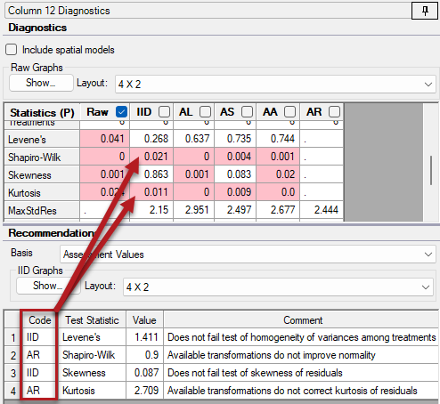
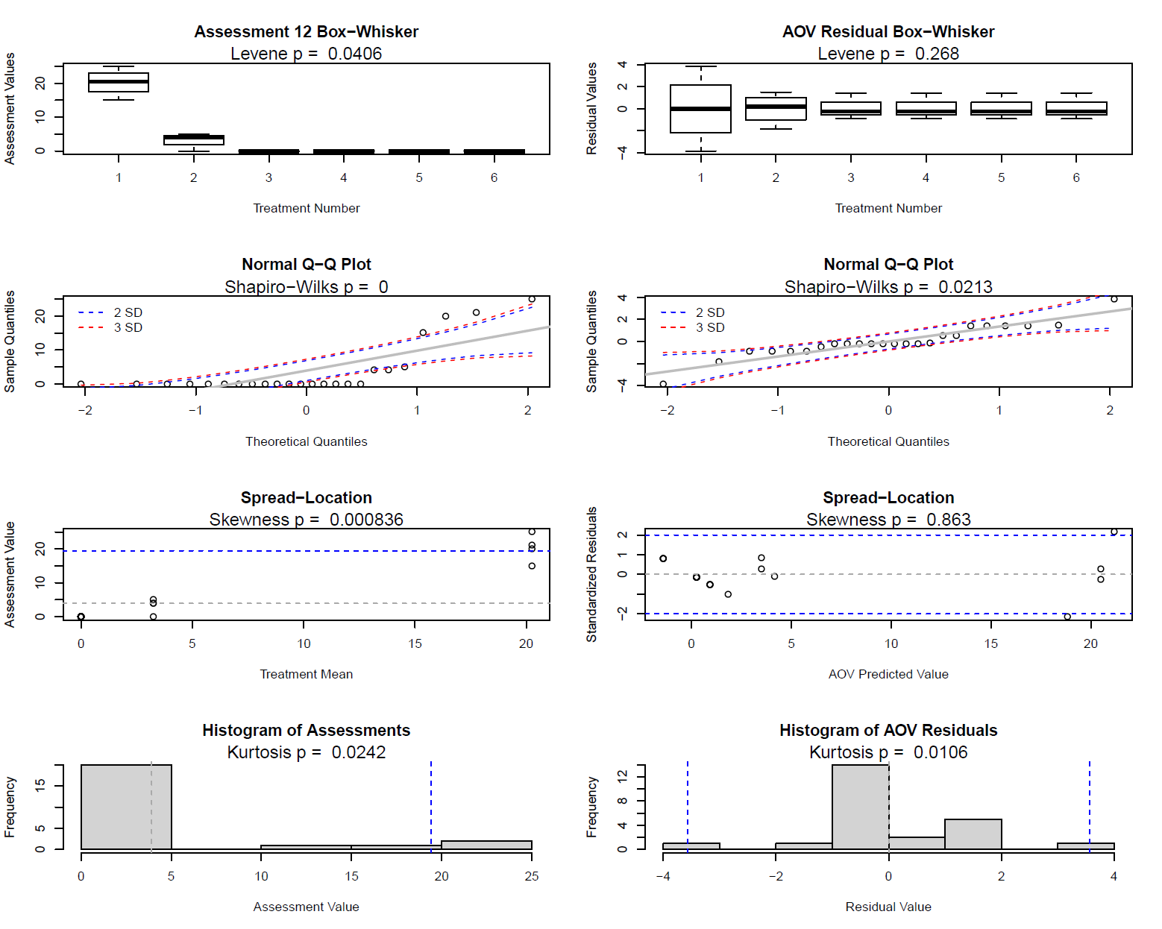
Column Diagnostics
Notes:
I’ve got one more example, when we aren’t fortunate enough to have a data correction transformation save the day. In this case, both Shapiro-Wilks and Kurtosis is not fixed with any of the transformations, so the recommendation is to use “AR”. This is the non-parametric statistics, which ranks the data points instead of relying on means and variances. The nice thing is, we can still get a mean of the ranks and so this analysis will still fit nicely on our report at the end.
*Real quick: You can also take a deeper dive into the data by using the “Show Graphs” button to draw diagnostic graphs. This helps visualize the data and the tests we’re using – but I don’t have time today to cover all of these graphs!

Slide 18
Step 3:
Analysis
Notes:
After reviewing the data, we are now ready to perform the analysis!

Slide 19
Example: 5 treatments, 4 replicates, harvested yield.
Degrees of Freedom (DF) = # independent comparisons can be made
  DF = n - 1
Sum of Squares (SS) = total amount of variation in the data
Mean Square (MS) = amount of variation ÷ degree to which it can occur
  MS = SS / DF
Source | Degrees of Freedom | Sum of Squares | Mean Square | F | Prob (F)
Between blocks (Rep) | 3 | 305.8 | 101.93 | 0.626 | 0.6121
Between treatments | 4 | 2258.8 | 564.7 | 3.466 | 0.0421
Error | 12 | 1955.2 | 162.93
Total | 19 | 4519.8
Notes:
Here is an example output of the AOV analysis, from a trial with 5 treatments and 4 reps.
*Degrees of Freedom is a bit tricky to define, but is the number of values in a final calculation that are free to vary. With variance, DF equals N-1, so for 5 treatments you have 4 degrees of freedom. [1~mean is calculated to determine variance]
*The Sum of Squares represents the amount of variation in the data, split up into each source listed in the table.
*The Mean Square is the Sum of Squares divided by Degrees of Freedom; we are taking the amount of variation and dividing it by the degree to which is can occur.

Slide 20
F ratio = indicates level of variation compared to random variation
  F = MS / Error MS
  Large F --> variance may NOT be due to random chance
Prob(F) = probability that variability occurred by chance
  Low p --> confident that real differences exist
Source | Degrees of Freedom | Sum of Squares | Mean Square | F | Prob (F)
Between blocks (Rep) | 3 | 305.8 | 101.93 | 0.626 | 0.6121
Between treatments | 4 | 2258.8 | 564.7 | 3.466 | 0.0421
Error | 12 | 1955.2 | 162.93
Total | 19 | 4519.8
Notes:
*Then we calculate an F ratio which indicates the level of variation from that source, compared to random variation. The larger this ratio is, the more likely that variance from this source is NOT due to just random chance.
*To quantify this, we calculate a p-value: the probability that observed differences in treatment (or block) means could have arisen by chance.
A low p-value (typically < 5%) indicates we can be confident that there are real differences among treatments. Whereas a high p-value (like between blocks) indicates that there is no evidence of a real difference (among blocks in this case). This could be because there is no real difference or that the differences are too small to detect.

Slide 21
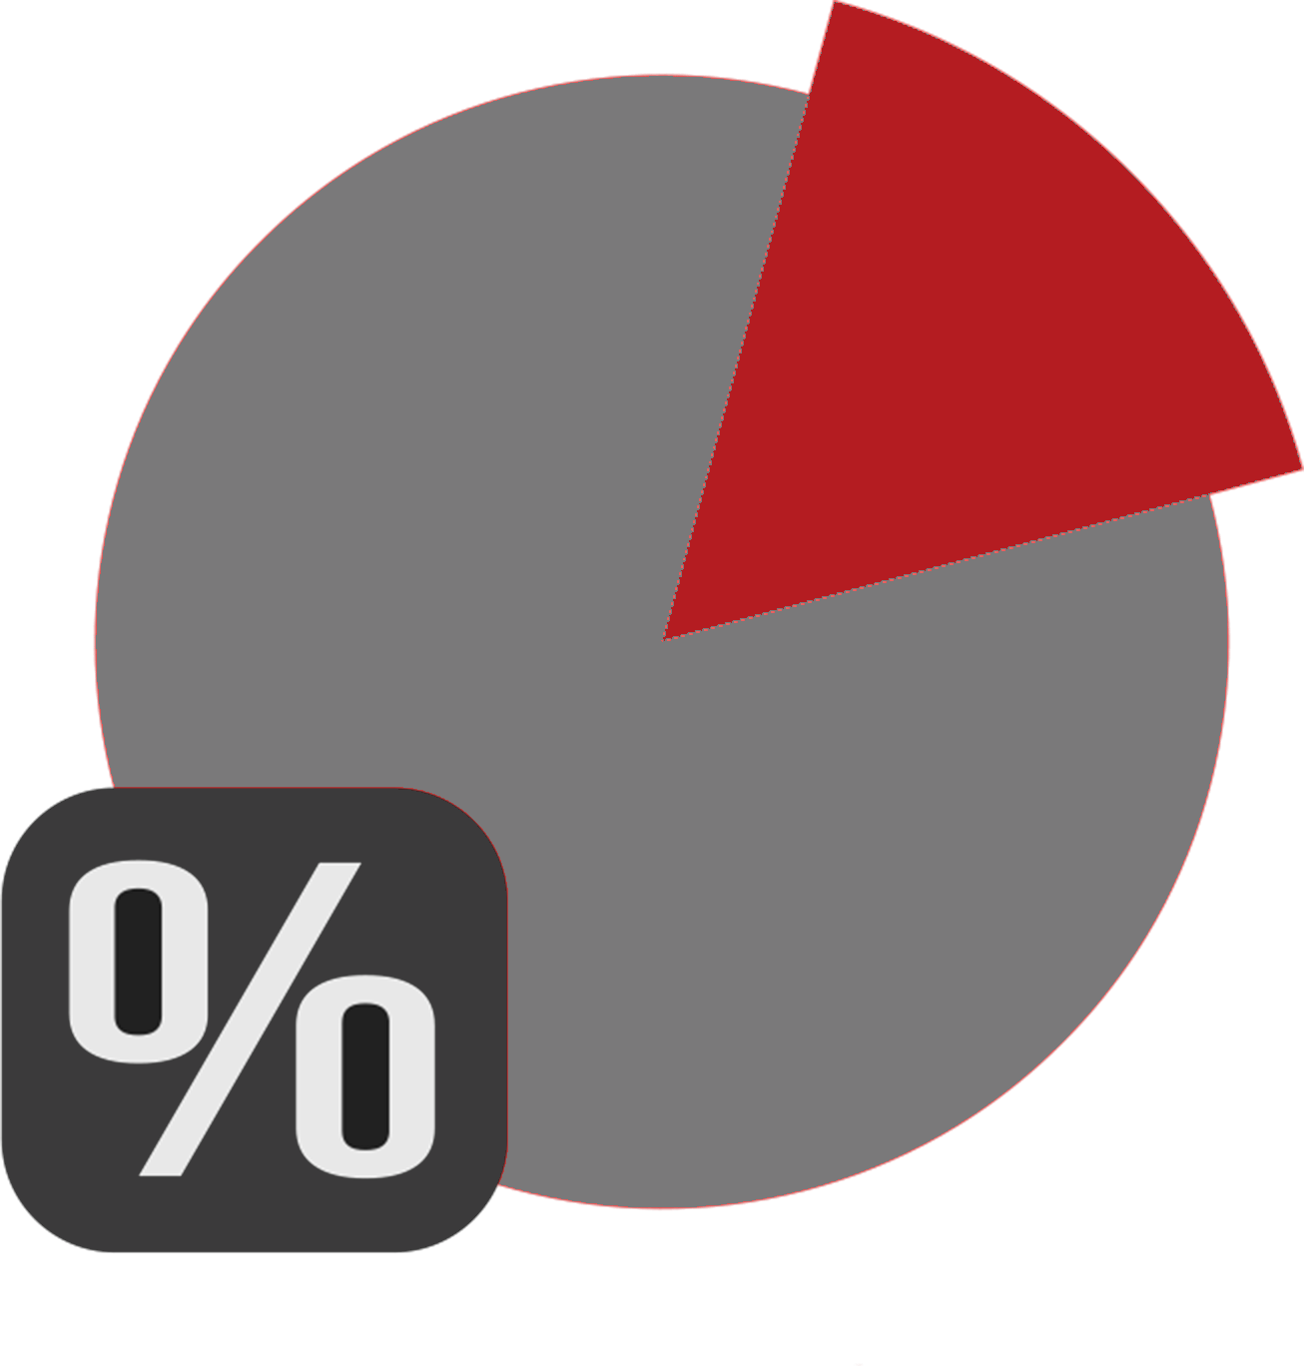
A long story short…
ANOVA breaks apart variance into sources
Calculates a P-value (= probability)
  p=% confidence that no differences exist
  p=0.04 -> 96% sure of differences
But we are not done yet!
Notes:
To summarize, the AOV analysis breaks apart the variance of observations into sources, then calculates a p-value as its end-result. Remember, a p-value is a probability!
*The AOV p-value is the probability that no differences in treatments exist. So a p-value of .04 means we are 96% confident that there are significant differences between treatments.
*BUT, we are not done yet! We need to know which observed differences between treatments are significant, and which are not!

Slide 22

Mean Comparison Test
Compare treatment means for significant differences
Different tests for different situations:
Significance level (or alpha, α)
  LSD
  Duncan’s
  SNK
  Tukey’s HSD
Notes:
The AOV analysis does not provide an answer about which observed differences in treatment means are significant, just whether there is evidence that a significant difference does exist. So the next step of the analysis is to run a mean comparison test. Also known as a “Mean Separation Test”, we compare treatment means to determine what differences are significant.
*ARM has a variety of mean comparison tests to choose from, for different situations and research types. The most common ones are LSD, Duncan’s New MRT, Student-Newman-Keuls, and Tukey’s HSD.
*We must also choose a significance level (or alpha) to run these tests. This is similar to the p-value for "confidence" in AOV results, but sets the threshold for significant differences for the test. Thus an alpha of (point)05 implies that we only accept differences that have a probability of 95% or higher of being true.
This selection should be made prior to running any analysis, as the choice should not be biased by desired outcomes.

Slide 23
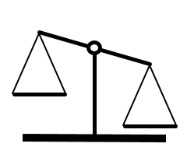
What to choose?
Liberal vs. conservative
  Type I vs. Type II error
Industry or sponsor standards
Purpose of study
Penalty of failure
Notes:
Tests can be classified by how liberal or conservative they are. This means that tests can be more likely to report a false positive (Type I error) or a false negative (Type II error), respectively. The first 4 tests listed in ARM are arranged from liberal to conservative. The liberal LSD is the most likely to report differences but suffers from higher false-positive rates, while you can be most confident in differences that the conservative Tukey's HSD reports, even though separation is less likely to be found.
*When deciding which to use, following industry- or discipline-standards is a good starting point. Or the study sponsor may request a specific test and alpha level.
*The purpose of the study should also be considered. When trial is used for registration, then a conservative test is appropriate. But a screening trial is all about potential, and so a more liberal test may be preferred, because any false-positives will be "weeded out" in future studies.
*Finally, consider the penalty of failure of the treatments. For example, the failure of a crop protection product will likely have an impact on yield, and so an alpha level of 5% is common. But for a biological product for plant health, the penalty of failure is just the cost of the product and so has a much lower penalty of failure. So a 15 or 20% significance level can be appropriate.

Slide 24
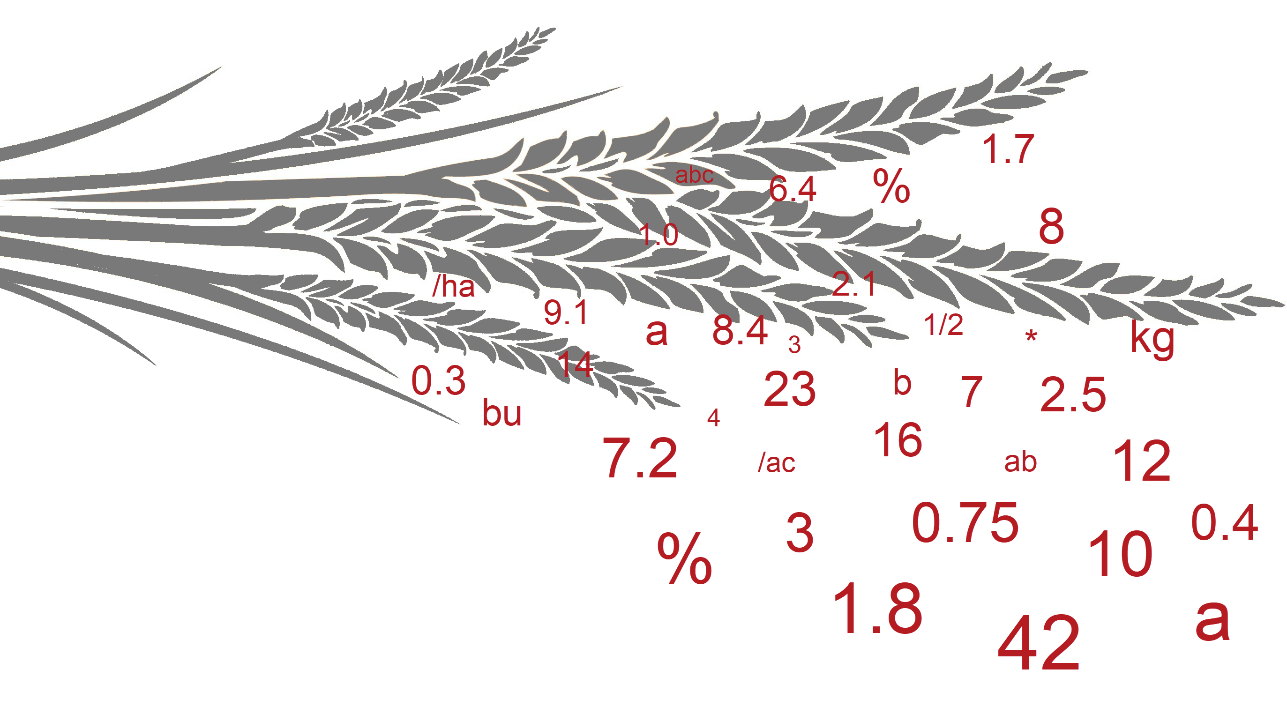
Show me the letters!
Calculate test statistic (LSD=5.49)
Compare means
  No significance if difference < statistic
Assign letters
Trt | Mean
1 | 54.91
2 | 45.77
3 | 43.97
4 | 51.08
5 | 55.04
Signif.
a
bc
c
ab
a
c
b
a
5
4
2
3
60
1
55
50
45
40
Notes:
Here’s an example of how a mean comparison test works. The specifics vary for each test, but the basic concepts are the same.
*First, a test statistic is calculated to perform the comparison of means. In our example we will use LSD at 5% significance level, which is 5.49 for this data.
*Then, compare the largest treatment mean to each of the other means, using the test statistic. If the difference between means is smaller than the LSD value, then they are not considered significantly different.
*To visualize this process, we can use a number line. The LSD value creates a range around each mean, and anything outside that range is significantly different according to the mean comparison test.
*Let's start with the largest mean, and extend to the lower bound. All treatments within this range are not significantly different, so we assign the letter 'a' to treatments 5, 1, and 4.
*Repeat this process for each mean. Because there are no new means in this next range, we don't need a letter here.
*The next range does include treatment 2, and so treatments 4 and 2 are assigned letter 'b'.
*The next range includes treatments 2 and 3 and is assigned 'c'.
*There are no more means without a letter, so we are finished. The letters are typically reported to the right of the means.
Learn about the reporting tools in ARM that are used to perform and present this analysis, in the AOV Analysis tutorial.

Slide 25
Step 4:
Reporting
Notes:
The final step is to put everything together for presenting to others.

Slide 26
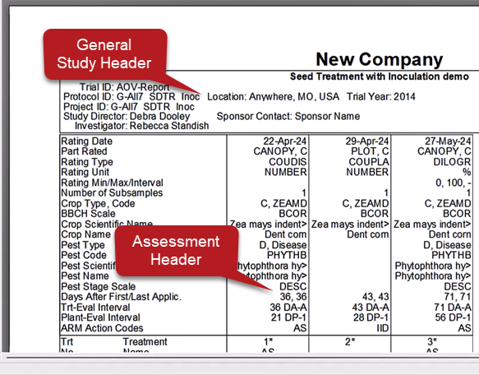
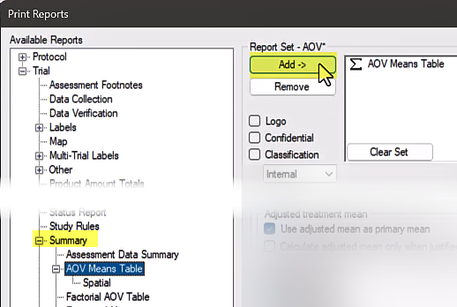
AOV Means Table
Notes:
To perform this analysis on a trial in ARM, first select File, then Print Reports. Under Available Reports, go to the 'Summary" section to select the AOV Means Table. Press Add to place this report in the list of components to generate. Then press Next to run the analysis and generate a report.
*Use Print Preview to view the report on the screen. Your company name will appear at the top, along with general header information from the trial.
Every rating from the trial is a column in the report table. First, we have the header description of each assessment.

Slide 27
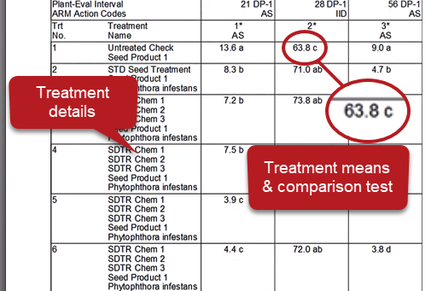
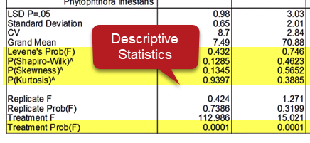
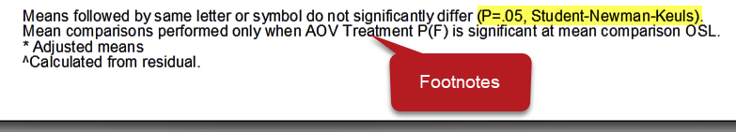
AOV Means Table
Notes:
Next in the report are the treatments. The key details from the Treatment editor are included here, with the treatment means for each assessment to the right. Next to the treatment means is the letter result from the means comparison test.
*Next on the table are the descriptive statistics, summarizing the entire column. The LSD, Standard Deviation, and CV are commonly included, and we also have the tests for AOV assumptions here. The last section is a brief version of the AOV table that includes just the F statistic and p value for the replicate and treatment sources.
*The final component of the AOV report is the list of footnotes at the bottom of the page. These provide important documentation of the analysis options used in the report. The first footnote details the alpha significance level and mean comparison test that was performed.

Slide 28
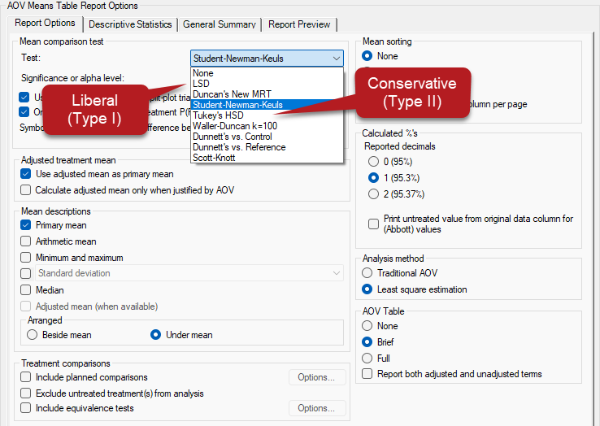
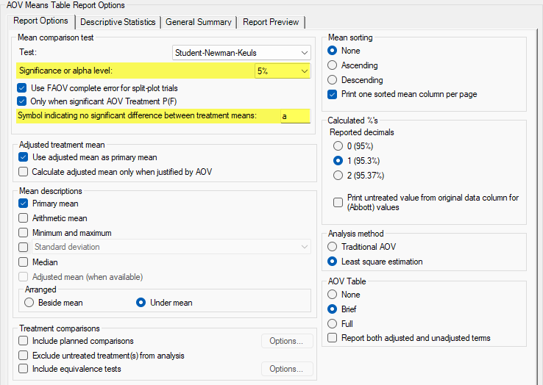
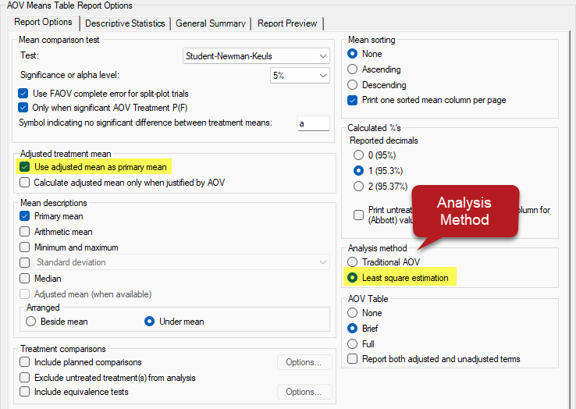
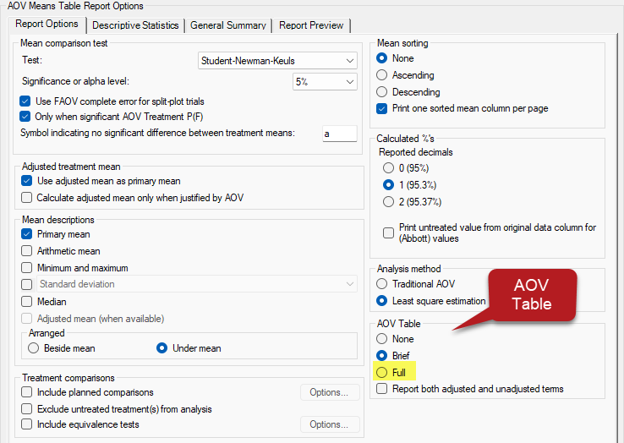
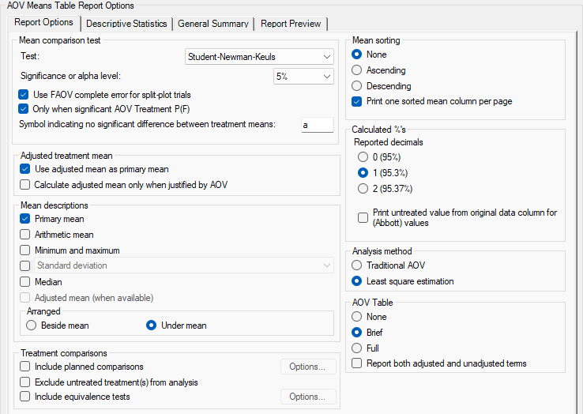
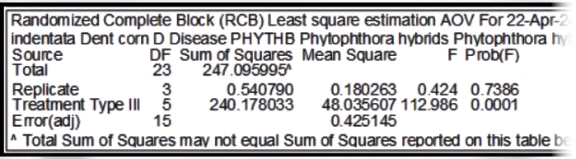
AOV Means Table
Notes:
Back on the Print Reports dialog, we can adjust the report options to cover the different statistical decisions we discussed previously.
*The mean comparison test options are first; The top four are the most common and appear in order of most liberal to most conservative.
*In the same section is the alpha significance level, and the symbol ARM uses in place of mean comparison letters when no significant differences are found.
*Another important choice is the analysis method. GDM recommends 'least square estimation', as it is more sophisticated compared to the Traditional AOV and handles missing data better. An adjusted mean is calculated using a linear regression model to minimize the sum of squared residuals, which is used on the report and in the mean comparisons.
*Finally, select how to display the AOV results. We saw the Brief version earlier with just the F and p values. The "full" option prints on a separate page and includes all AOV calculations for each assessment.

Slide 29
Recap – Statistics & ARM
AOV breaks apart variance into sources
Mean comparison test: what is significant?
Assumptions of AOV are important
Notes:
*In summary, the AOV analysis breaks apart the variance of observations into sources, then calculates a p-value probability.
*Then we perform a mean comparison test to determine which treatment mean differences are significant.
*But we must be cautious with this analysis – if the data does not fit the assumptions, we cannot rely on the results. Therefore, steps like Data Confirmation and Data Review are important prior to analysis and reporting of results.

Slide 30

Giveaway
  https://gdmdata.com/NAICC
  Click on survey link
  Fill out feedback form to enter to win:
    1 Free EDC add-in
    1-year data plan
  Reminder: Sign in for CEU’s for CCA and CPCC programs

