Slide 1
What’s New in ARM?
Updates to ARM software in 2025

Slide 2
Study Rules

Slide 3
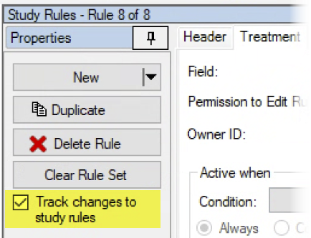
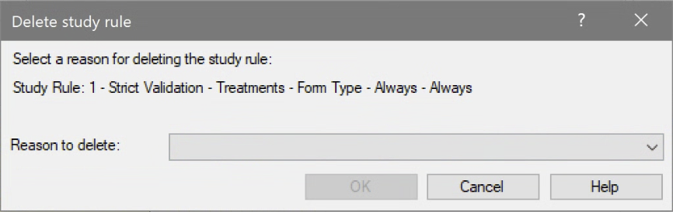
Track changes to Study Rules
New option logs changes to study rules in a trial
Tracks when rules are deleted or downgraded (e.g. Required to Recommended)
Select a Reason to click OK and proceed with the change or deletion
1 of 4

Slide 4
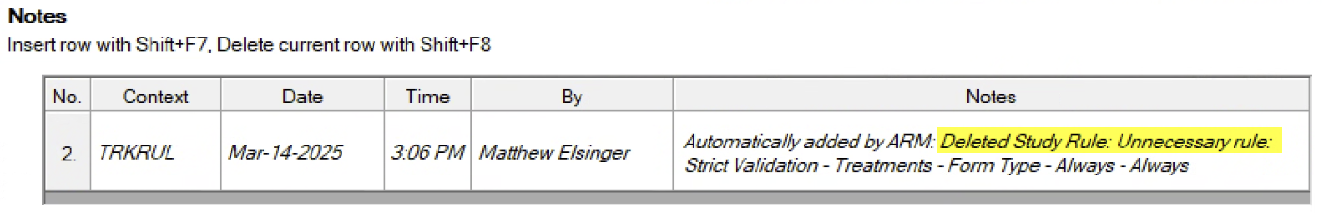
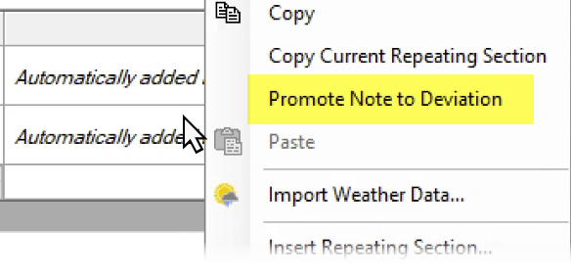
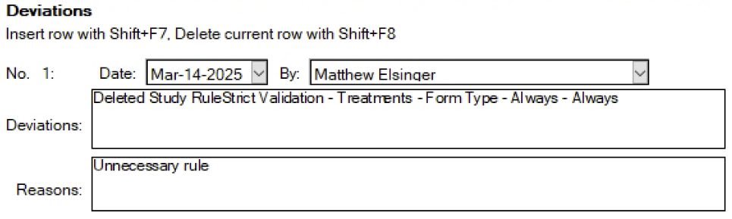
Track changes to Study Rules
The change and reason are logged as a Note in the trial
Right-click > Promote Note to Deviation creates a deviation record too
2 of 4

Slide 5
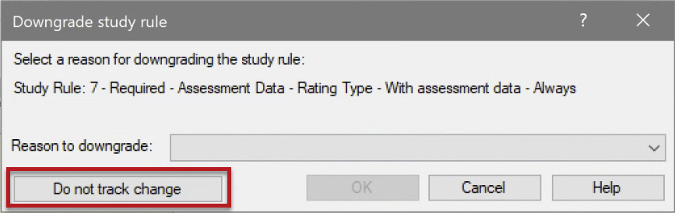
Track changes to Study Rules
Only the Protocol Owner can turn tracking on or off
Protocol Owner can also skip tracking of a particular rule change:
Note: this does not affect Permissions to Edit Rule functionality. Users must still have rights to make changes to rules in the first place.
3 of 4

Slide 6
Why Track changes to Study Rules?
Require documentation for departures from standard rules and requirements There may be a good reason the rule could not be followed, let us know!
Is the trial still valid? If critical rules were removed/changed, the trial may need to be repurposed
Provide feedback for future study rule sets What rules caused issues for trialists? Why are rules being removed? Etc.
4 of 4

Slide 7
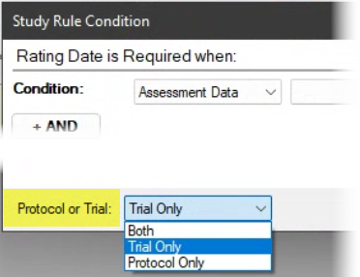
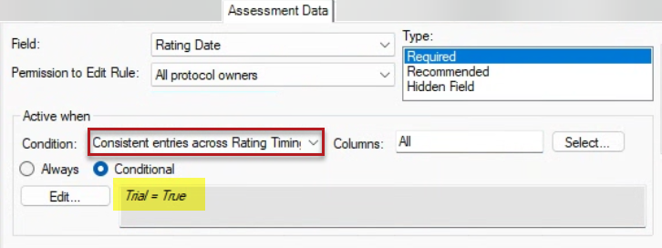
“Consistent Entries across…” study rule
New Conditional capability for Consistent Entries assessment rules:
Specify if rule applies to Protocol or Trial or Both
Adds flexibility in setting up planned ratings vs. final columns in a trial

Slide 8
Site Description

Slide 9
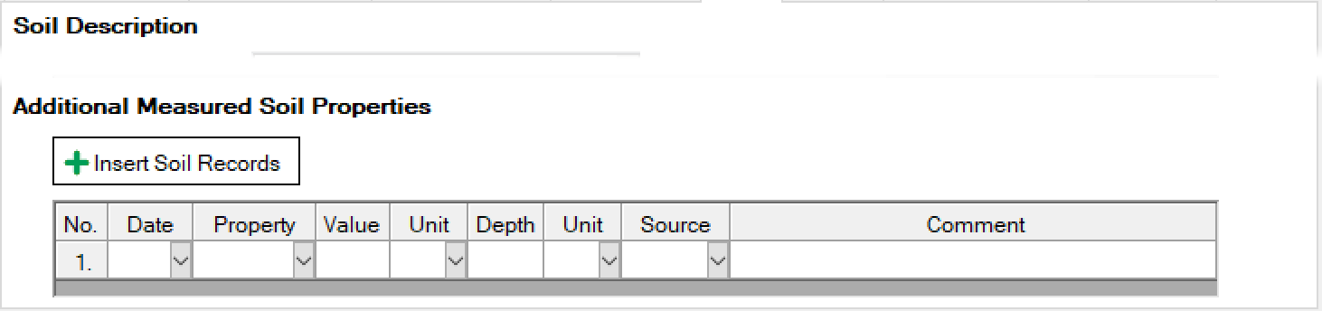
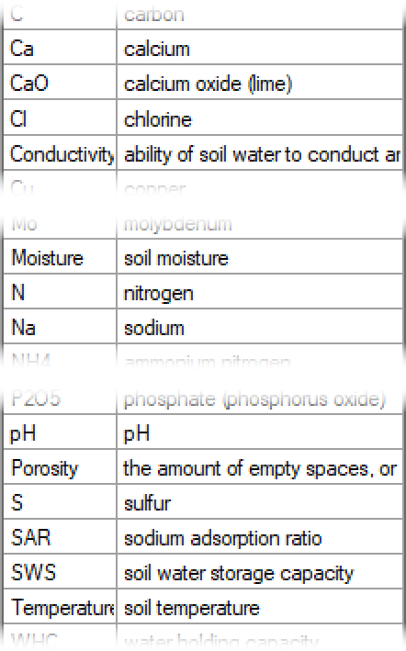
Soil Properties to Measure
“Measured Elements” section is now “Measured Properties”
Document more than just basic elements in the soil e.g. temperature, moisture, water holding capacity
Also added Source field: free-text to document the source of the measurement, e.g. the lab or station that processed the sample

Slide 10
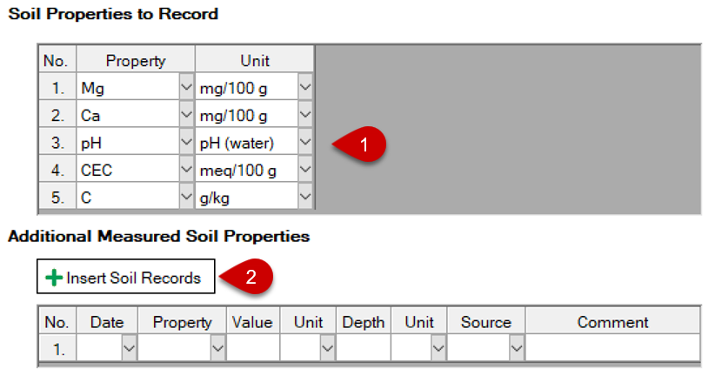
Recording Soil Properties
New workflow to record soil properties, especially for repeated analyses
Select properties and units to record (can be specified in Protocol)
For a given analysis date, select Insert Soil Records button
1 of 2

Slide 11
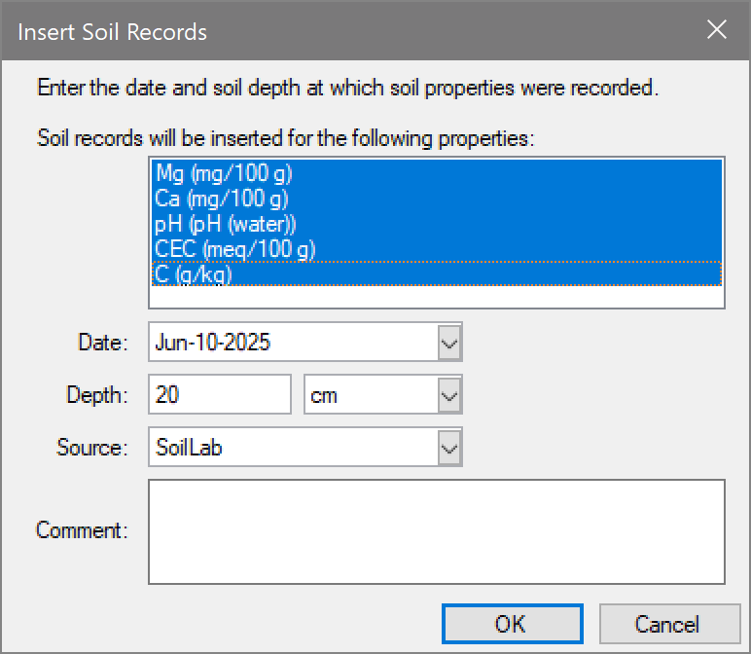
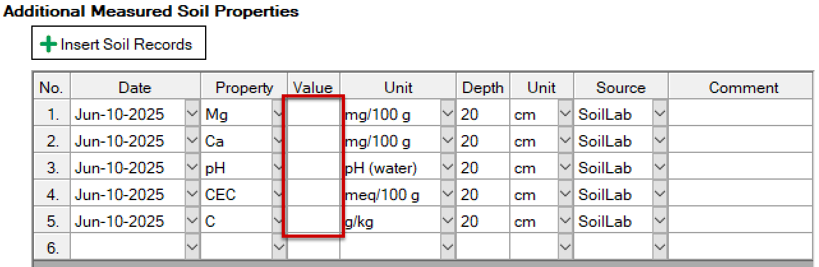
Recording Soil Properties
Confirm properties to record and enter other details about the sample
Click OK to insert and auto-fill rows for selected properties to record
2 of 2

Slide 12
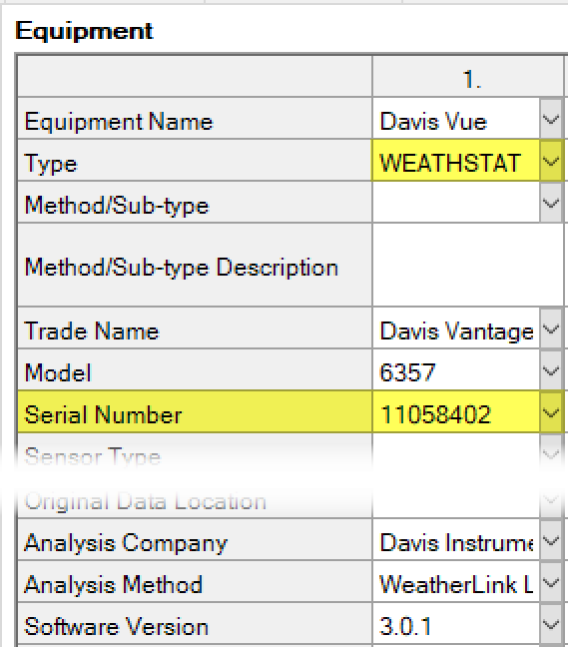
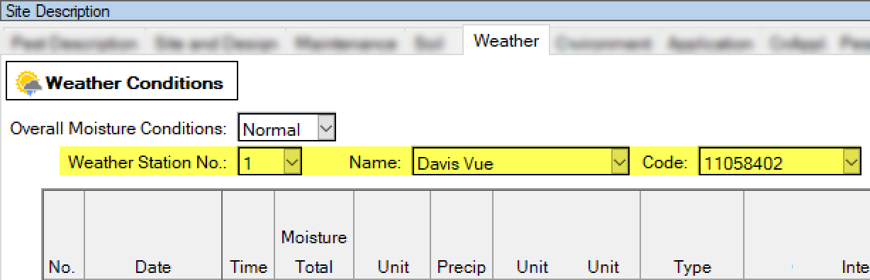
Weather Stations
Document weather station details and link to Weather records
Add station as ‘WEATHSTAT’ in Equipment tab
Link Weather conditions to station with Weather Station No field
The field Code displays the Serial Number from Equipment

Slide 13
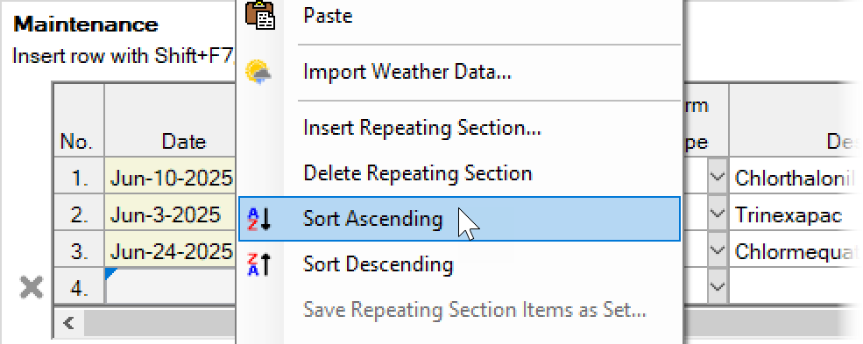
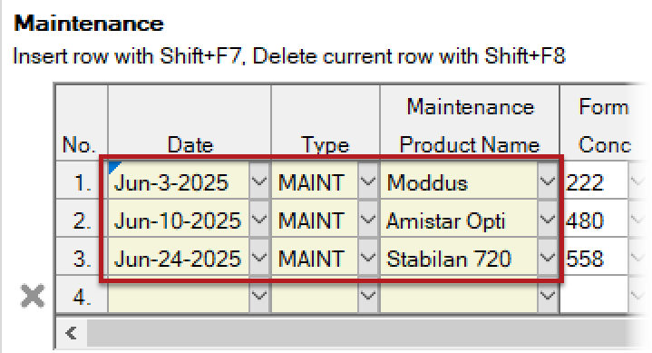
Sorting Site Description tables
Added support for sorting the "add-row" grids based on their content
Not a temporary view, but re-orders the repeating sections
Examples include:
Trial Location table
Weather/Controlled Environment
Maintenance

Slide 14
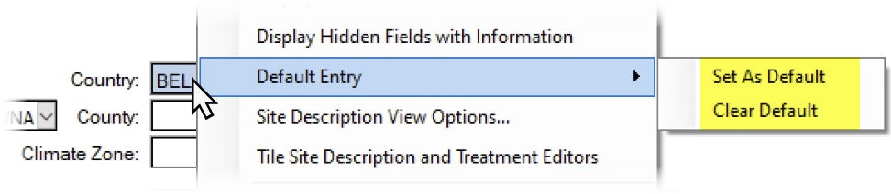
Set As Default
Save values as default with “Default Entry” right-click menu
Defaults are inserted when creating or opening a study where the chosen field is empty
Remove existing default values using Clear Default command

Slide 15
Unit Defaults
Improved the auto-fill of height, length, and moisture units:
Use the unit already entered in a linked field
Use the unit already entered in a previous repeating section of this field
Use the default saved previously by right-click > Set as Default
If no default from 1-3, then use Metric or Imperial default
1 of 2

Slide 16
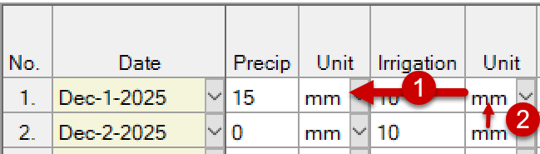
Unit Defaults
Improved the auto-fill of height, length, and moisture units:
Use the unit already entered in a linked field
E.g. Irrigation unit defaults to choice in Precip amount entered in same row
Use the unit already entered in a previous repeating section of this field
E.g. Irrigation unit in row 2 defaults to unit chosen in row 1
Use the default saved previously by right-click > Set as Default
E.g. If I have saved ‘mm’ with the Set as Default, use that for Irrigation Unit
If no default from 1-3, then use Metric or Imperial default
E.g. For moisture, Metric default is ‘mm’ and Imperial default is ‘IN’
2 of 2

Slide 17
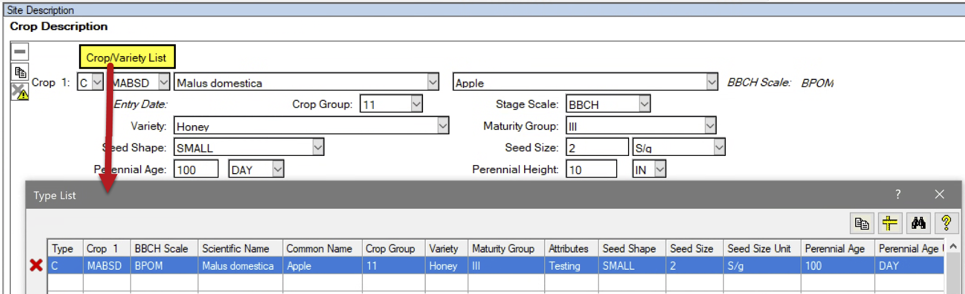
Crop/Variety List
Added picklist for saving/selecting commonly used Crop+Variety details
To fill: enter all Crop details then click Crop/Variety List button to add new record to your list

Slide 18
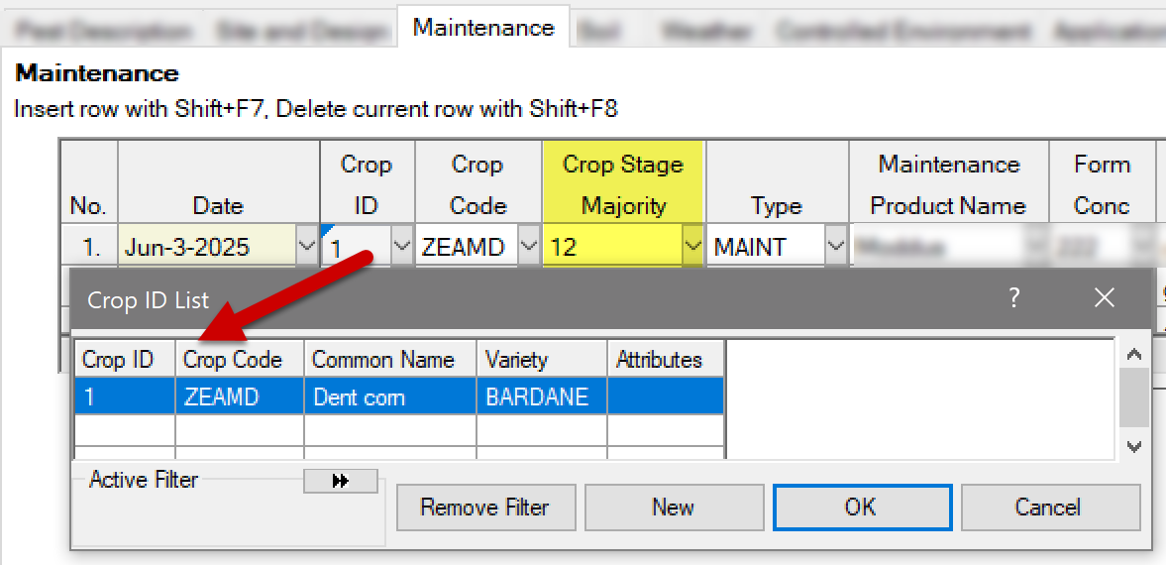
Maintenance – Crop Stage
Document Crop Stage at time of Maintenance application
Note: Must first link to existing Crop record using Crop ID field

Slide 19
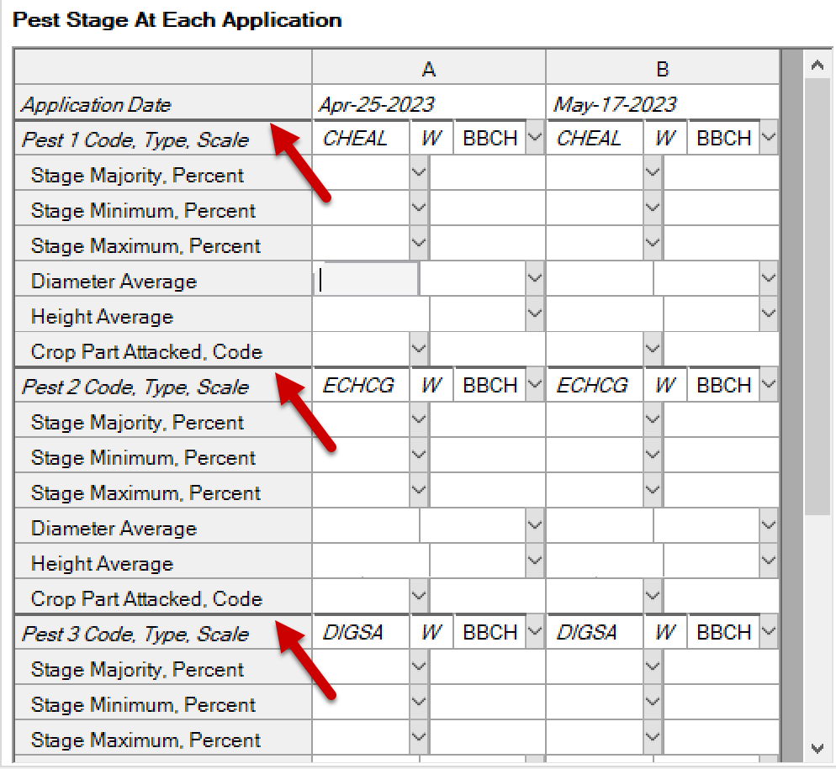
Stage at Application separators
Added darker separator lines between each crop/pest on the Stage at Application sections

Slide 20
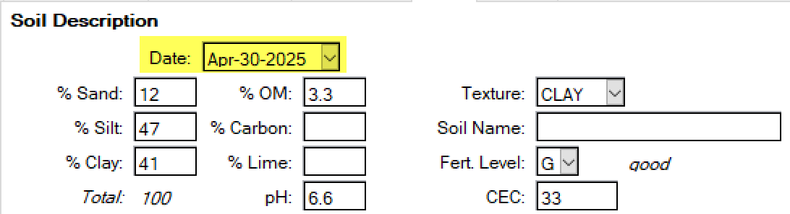
Soil Description Date
Added field to describe the date that the soil sample was taken
For some site types, these details may have been taken years ago!

Slide 21
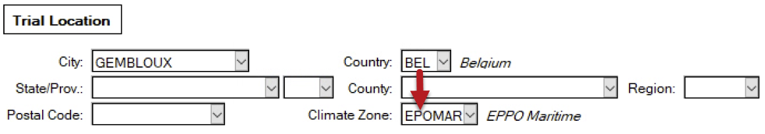
Climate Zone (EU only)
ARM now auto-fills the Climate Zone when an EU Country is selected
For countries with multiple climate zones, auto-fill waits for State/Prov or County to be filled (e.g. Croatia or France)
Exception: When Site Type is set to a controlled environment, then “N/A” is auto-filled for Climate Zone

Slide 22
Labels

Slide 23
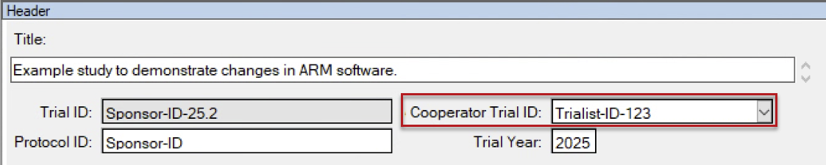
Raw Data Labels
Added Cooperator Trial ID field to CSV output for Raw Data Labels
Why? Sponsor may use Trial ID, so trialist uses Cooperator Trial ID for their own naming convention
Create your own custom labels with ARM: https://gdmdata.com/Resources/Video-Tutorials/Custom-Labels-with-ARM

Slide 24
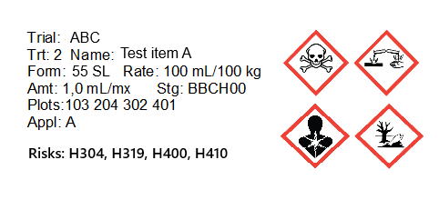
Raw Data Labels
Added Risk Phrase and Safety Phrase fields to CSV output for Treatment label formats
Why? To communicate risks attributed to dangerous substances and/or important safety advice

Slide 25
Attachments

Slide 26
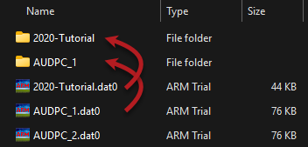
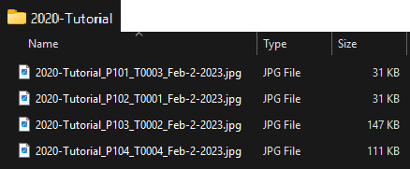
Attachment location
Now also searches for attachments in a subfolder named after the study ID within the current data file path.
An alternative to saving attachments in the same folder as the trial

Slide 27
Login

Slide 28
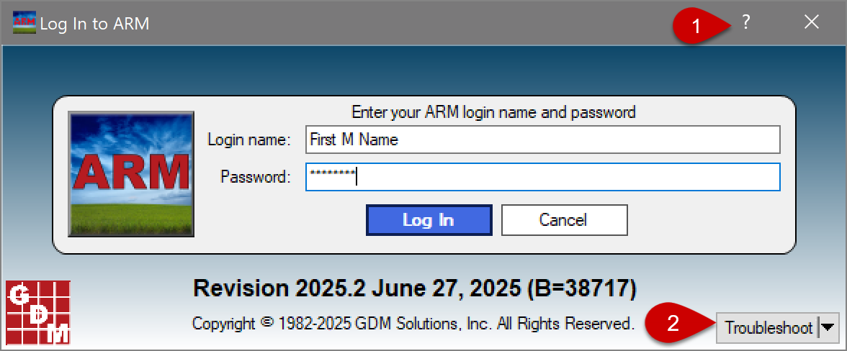
Updated Login Prompt
New ? button opens ARM Help
Troubleshooting options are easily accessible if errors occur

Slide 29
Assessment Data

Slide 30
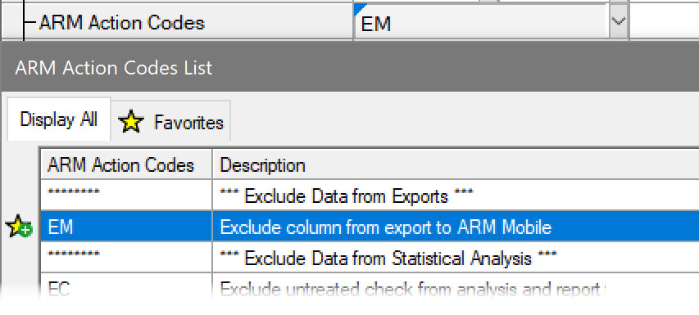
Exclude from ARM Mobile export
New Action Code EM removes columns from data collection export
Why? Some planned assessments are not for data collection apps, such as soil sample ratings

Slide 31
Electronic Data Collector (EDC)

Slide 32
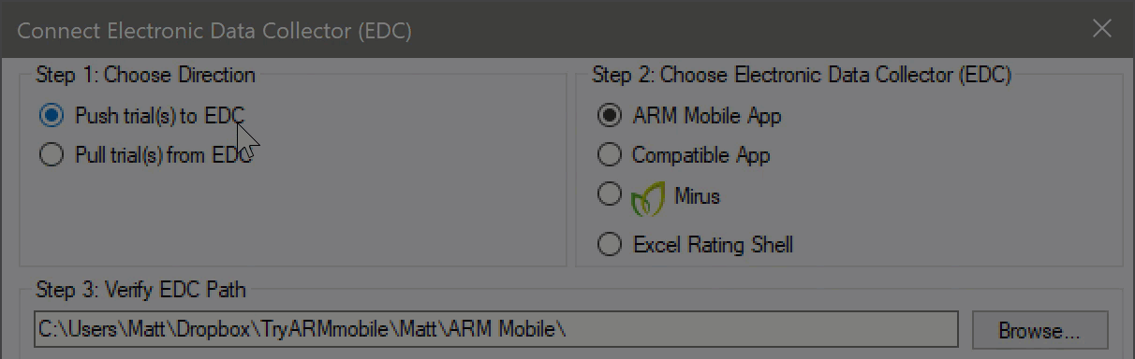
EDC – Compatible App
Changed to save Compatible App path separate from ARM Mobile path
Now both ARM Mobile and a different “Compatible App” can be used in tandem by the same user

Slide 33
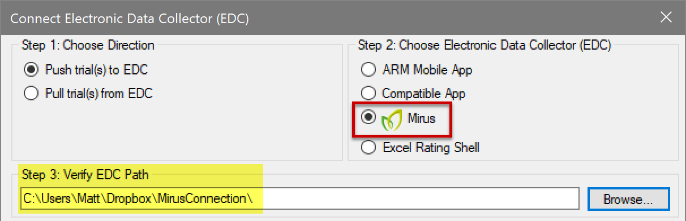
EDC – Mirus connection
Choose the path to create trials for Mirus & import data from Mirus
Note: ARM automatically creates Imports, Exports, and Finished folders
Previously this only worked for folder ‘C:\HarvestMaster\Mirus’ on your hard drive

Slide 34
ARM Mobile

Slide 35

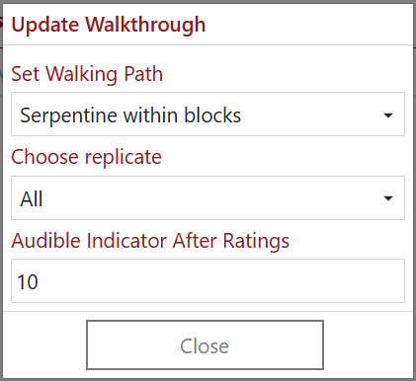
ARM Mobile app updates
Improved subsample workflow:
New Walkthrough option: “Audible Indicator After Ratings”
Plays a sound after the specified number of values are inputted
Used when only taking a certain number of subsamples at a time, e.g. half of the plot
When moving to a plot, focus goes to the first rating without a value
Useful when doing a subset of ratings/subsamples and returning to a plot to finish

Slide 36
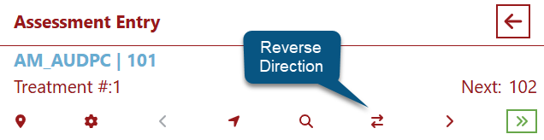
ARM Mobile app updates
Added an option to reverse the Walkthrough direction while entering data
Changes current Walkthrough direction to “Reversed”, to change Next plot to the opposite direction
1 of 2

Slide 37
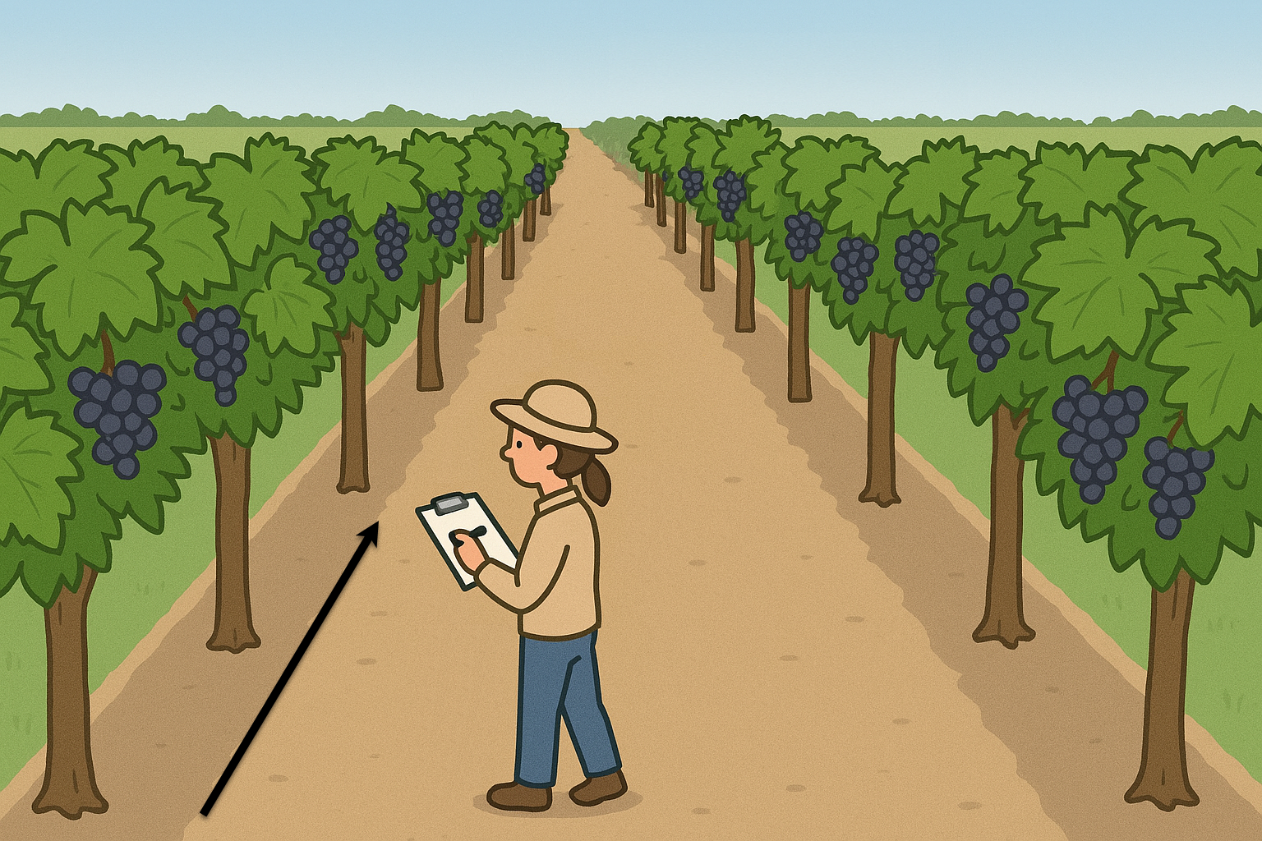
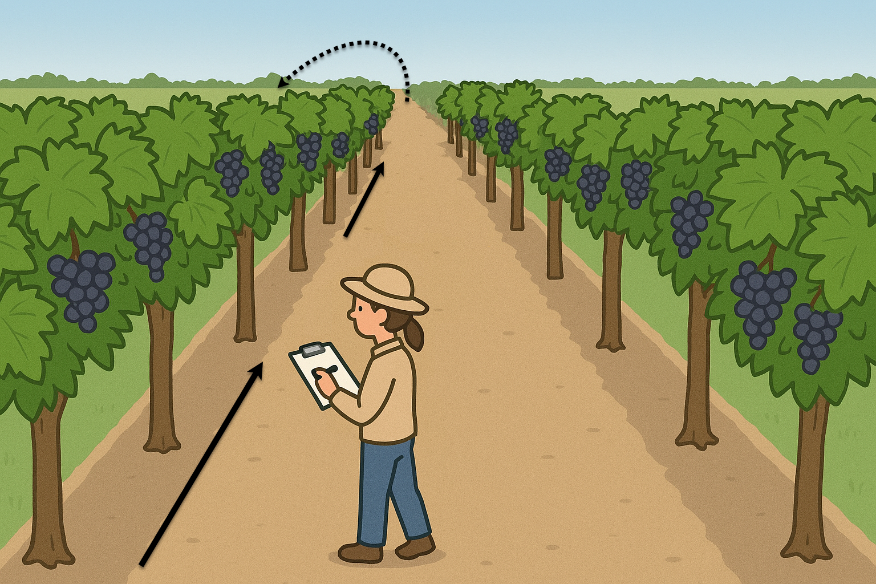
ARM Mobile app updates
Use Case: In vineyard, half of subsamples are taken on one side of the vine, all the way down the row. Then the researcher “flips” to the other side and returns back to the previous plots for the rest of ratings.
2 of 2

Slide 38
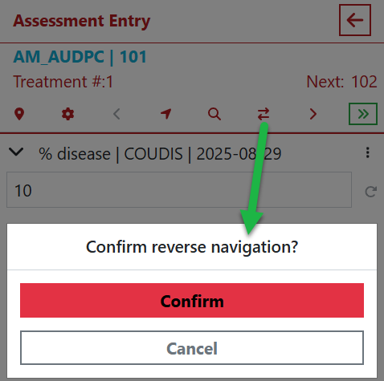
ARM Mobile app updates
New prompt when using Reverse Direction button
Feedback from users: new button affected muscle memory, so prevent accidental direction changes with a prompt

Slide 39
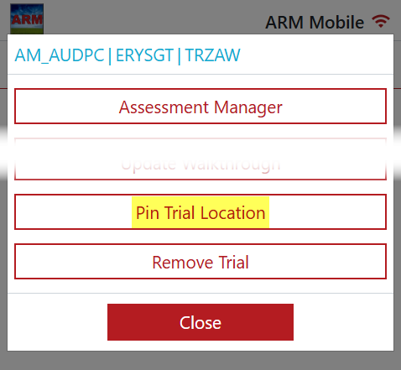
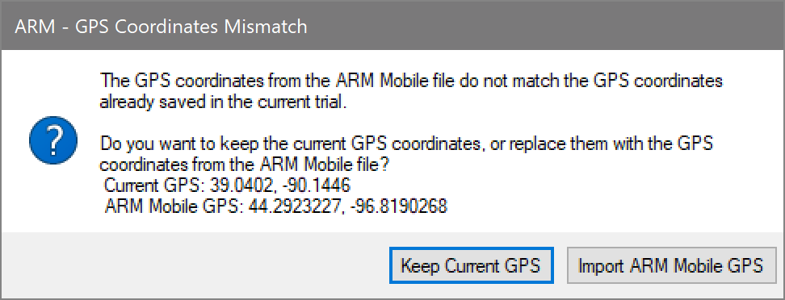
ARM Mobile app updates
Added support for importing GPS coordinates from ARM Mobile to LL Corner fields in Site Description
Option to overwrite existing values, if app is more accurate:

Slide 40
Tips & Techniques
Impactful updates from recent years that are worth another look!

Slide 41
Copy Application Column
ARM Powered by GDM Solutions

Slide 42
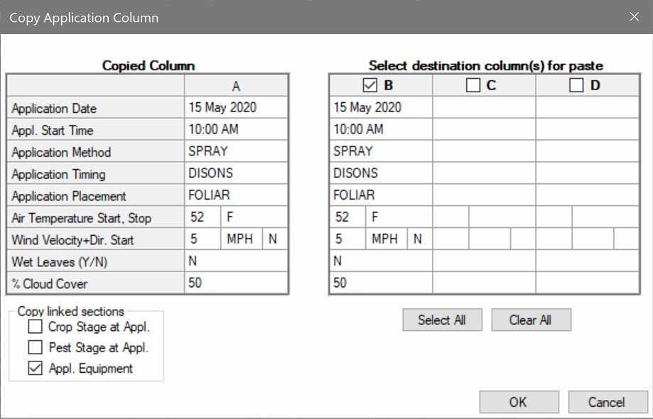
Copy Application Column
Duplicate application details that are common to other application codes
Notes:
#11500

Slide 43
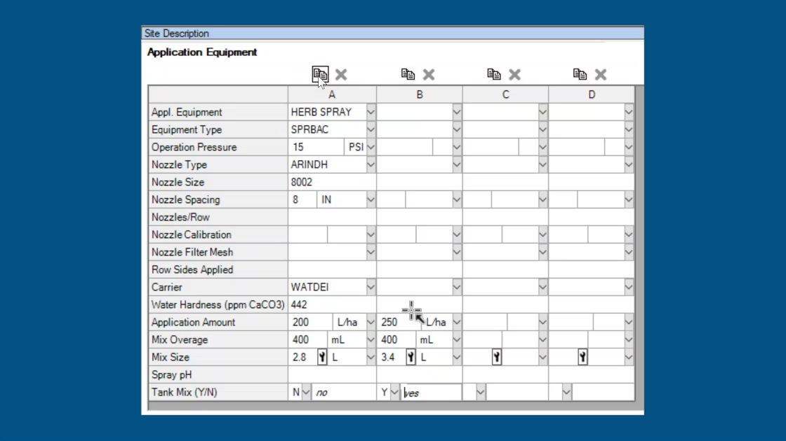
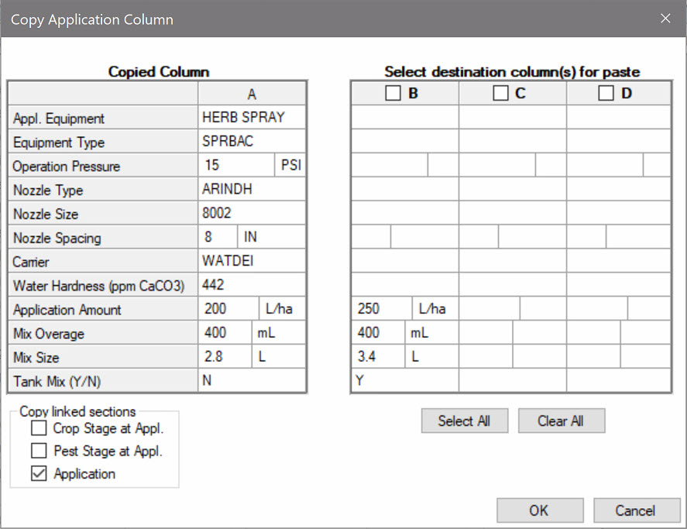
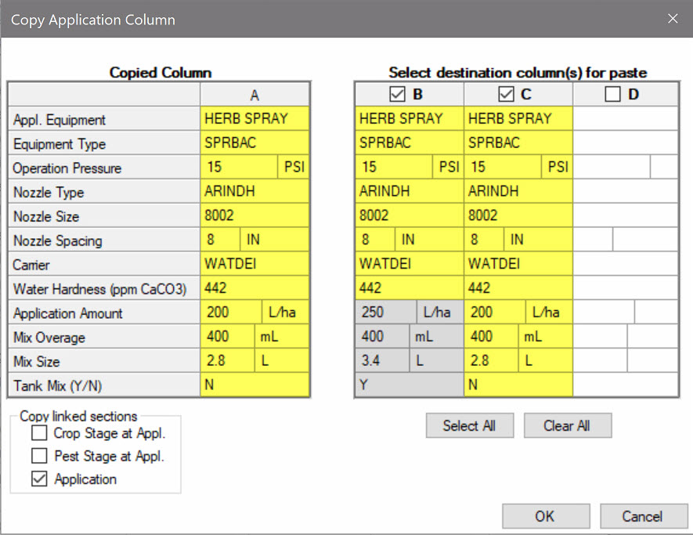
Copy Application Column
Feature in Action:
Paste information to empty fields of selected Application Codes
Perform action on other application-related tabs at the same time
Notes:
#11500

Slide 44
Application Not Applied
ARM Powered by GDM Solutions

Slide 45
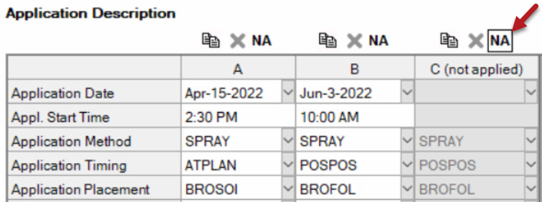
Application Not Applied
Identify an application that is not applied
Purpose: Retain a planned application code, but denote that it was not performed
Process: Toggle NA button above application
Notes:
#W5

Slide 46
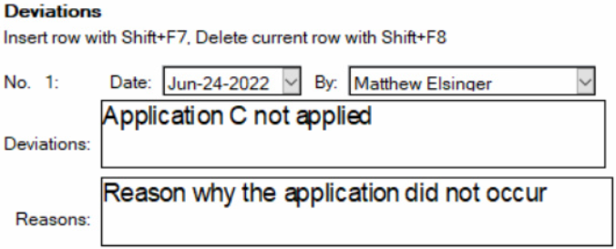
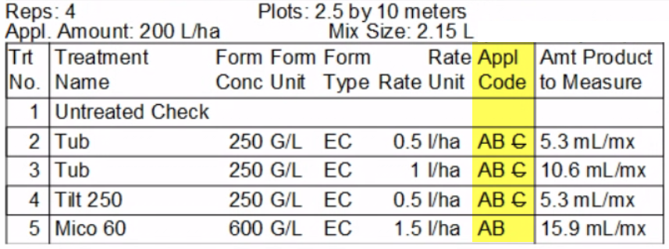
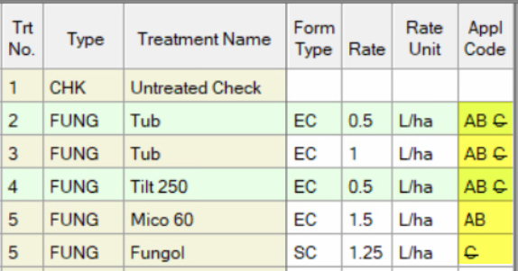
Application Not Applied
Impact:
Enter a deviation to explain circumstances
Not included in product calc's
'NA' applications display with strikethrough
Appl. Date field can be blank without failing validation if marked 'NA'
Notes:
#W5

Slide 47
Custom Labels
ARM Powered by GDM Solutions

Slide 48
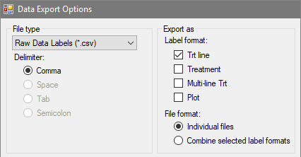
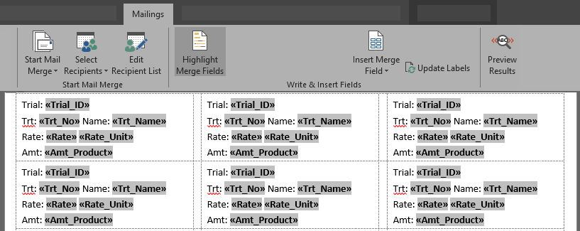
Custom Labels
Create custom labels by exporting treatment/plot information to .csv
Use Mail Merge in a word processor to create your own labels
Notes:
#10765

Slide 49
Import Weather Data
ARM Powered by GDM Solutions

Slide 50
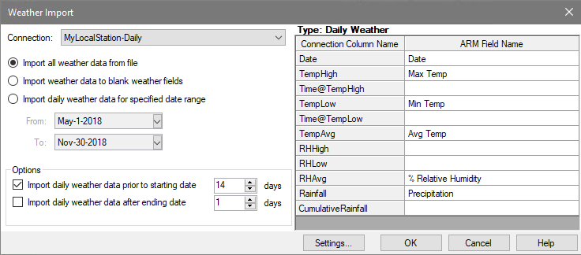
Import weather data
Import weather data from any weather source CSV file
Define connection between CSV and ARM fields
Specify what dates to import data from file
Notes:
#10902

Slide 51



Import weather data
Define connection type and read column headings from CSV
Map CSV headings to ARM weather fields Hourly = Application; Daily = Weather table
Notes:
#10902

Slide 52
Multi-factor Designs
ARM Powered by GDM Solutions

Slide 53


Factorial CRD
Completely Random Design w/factorial treatment arrangement
Useful where blocking is not needed (e.g. greenhouse/lab trials)
Previous "Factorial" design renamed to "Factorial RCB" to clarify
Notes:
#12283
useful in the case of pot, growth chamber, or lab trials, where blocking is not needed.

Slide 54


Multiply out treatments
Convert protocol factor levels to the full "multiplied out" list
Useful to edit "full" treatment list while still in the protocol
1 of 2
Notes:
#12170

Slide 55

Multiply out treatments
Feature in Action:
Note: once protocol treatments are converted, they cannot be reverted back to the original factor level view. Only Edit > Undo can reverse this action.
2 of 2
Notes:
#12170

Slide 56
Schedule Tasks
ARM Powered by GDM Solutions

Slide 57


Connect to Outlook
Send ARM tasks to any calendar linked in Outlook
Previously could only send to the default calendar, limiting sharing options
1 of 3

Slide 58



Connect to Outlook
Right-click to unlink task from Outlook
Send tasks to different calendars by unlinking then sending again
2 of 3

Slide 59


Connect to Outlook
How do I create a new calendar?
Calendar > Add > Create New Blank Calendar…
How do I share this calendar?
Calendar Properties > Permissions > Add > [Person] + Can Edit
3 of 3

Slide 60
SE Definitions
ARM Powered by GDM Solutions

Slide 61

SE Definitions
Plan and define standard evaluations (SEs) and tasks to use in the study
Simpler than importing SEs from file into assessment data editor
Use Tools > 'Build Headers' and 'Build Tasks' to create the SEs and tasks defined in this tab
Multiple rating timings create columns and tasks for each timing code
Two-column SE F097_C2 times 3 rating timings A1-A3 = 6 total data columns
Notes:
#10333

Slide 62

SE Definitions
Display SE Name list
Select an SE, can search/filter descriptions
Preview assessment columns defined in SE
Can also define tasks on this tab to add to Schedule editor
Notes:
#10333

Slide 63
Social Media
ARM Powered by GDM Solutions

Slide 64

Yield Conversion
Use ARM's Yield Conversion dialog to convert yields per plot to standard yield units.
Specify the current yield unit and desired yield unit.
Select moisture adjustment if needed.
Note: must specify either crop or bushel test weight when converting to bu/a.
Enter harvested plot size in the Settings dialog.
Specify column number to convert (harvested yield in original units) and the column number to store converted yield.
Alternatively, you can enter a conversion factor for ARM to calculate the converted yield. While called a yield conversion, the factor can be any multiplier you wish to apply to assessment data within one column. ARM cannot adjust moisture when you enter a conversion factor directly.
Notes:
#10333

Slide 65

Fill Header Rows
Use this shortcut to copy a header row to several assessment data columns at once:
Click on the header you want to copy.
Right-click and select "Assessment Data Column Tools."
Select "Fill Header Row."
Enter the number of data columns to copy in the header row.
Enter the source column number to copy from.
Enter the first column to copy the information.
Click OK.
Notes:
#10333

Slide 66

Move Assessment Columns
Use this shortcut to move an Assessment Data Column to a different spot in the editor:
Right-click and select "Assessment Data Column Tools."
Select "Move column."
Select the information you wish to move - the data header, assessment data, or both.
Enter the number of columns to move.
Enter the column to be moved (or the starting column number if moving multiple columns).
Enter the column number where you want to move the information.
Notes:
#10333

Slide 67

Sort as Tabs
Organize your assessment data columns for accurate data entry and efficient data review!
1. Select 'View Options' in Properties panel OR Tools > Options.
2. Select 'Display sort as tabs’
3. Use the Sort column to change the order in which data columns are displayed.
For example, to sort assessment columns first by Pest and then Rating Timing:
-Type the number 1 in the Sort column for Pest Name
-Type the number 2 in the Sort column for Rating Timing
4. Click OK to apply the sort.
Notes:
#10333

Slide 68
Sort as Tabs
Quickly switch between tabs at bottom of Assessment Data editor.
Notes:
#10333

Slide 69

Paste Special
Copy a treatment line to multiple selected treatments with Paste Special.
1. Select and copy the desired treatment line by right-clicking and choosing 'Copy Current Treatment Line.'
2. Right-click again and select 'Paste Special.'
3. Specify the treatment numbers where the treatment block should be copied.
Clipboard contents are added at the end of selected treatments. Any treatment number information in the clipboard is ignored.
Notes:
#10333

Slide 70



GDM Social Media
LinkedIn
Facebook
YouTube
Notes:
#10333

Slide 71

Giveaway
https://gdmdata.com/NAICC
Click on survey link
Fill out feedback form to enter to win:
1 Free EDC add-in
1-year data plan
Reminder: Sign in for CEU’s for CCA and CPCC programs

